Slide 1
Microsoft Azure:
Azure was developed by Microsoft and launched on 0ctober 2008.
Azure is a public cloud computing platform with solutions (Iaas,Paas and Saas)
and it is used to protect our data and code and mainly IT proffessionls are used
to build,deploy and manage applications through our global network data centers.
> Azure subscription is a container that hold a collection of connected technical resources and
we have to pay as per we use for the cloud.

Slide 2
Resource group:
Resource group is nothing but the collection of resources.
It is a platform where we can place all the resources for a particular application.

Slide 3
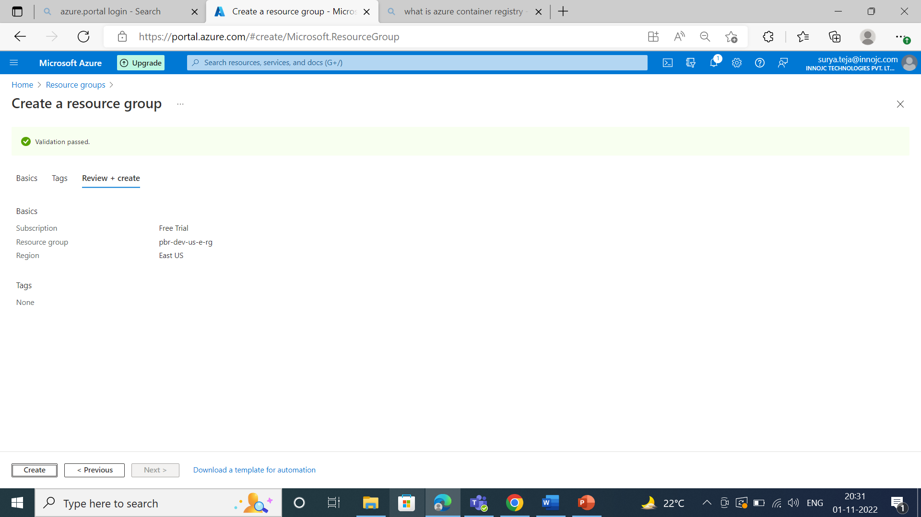

Slide 4
We are creating the resource group, pbr is the name of the project and dev is (we are creating resource group under development environment) and US (united states)where we are going to deploy our resource group and E is the East (region) and rg is the short form of our resource group.

Slide 5
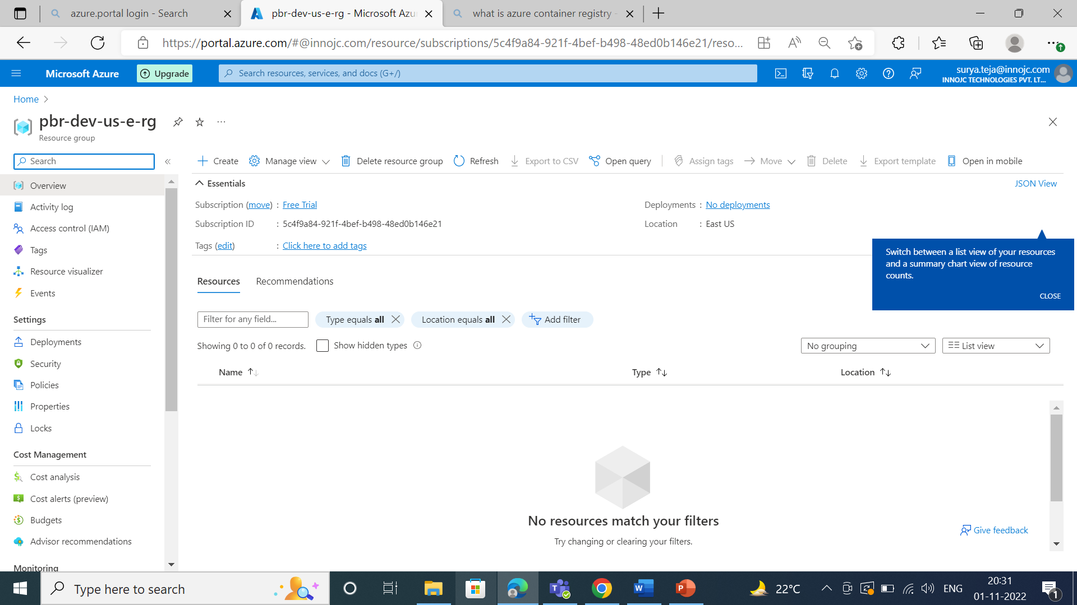

Slide 6
Virtual network:
What ever the resources are running or created that should be in our control
So we are creating virtual network.
Short form of virtual network is Vnet.

Slide 7
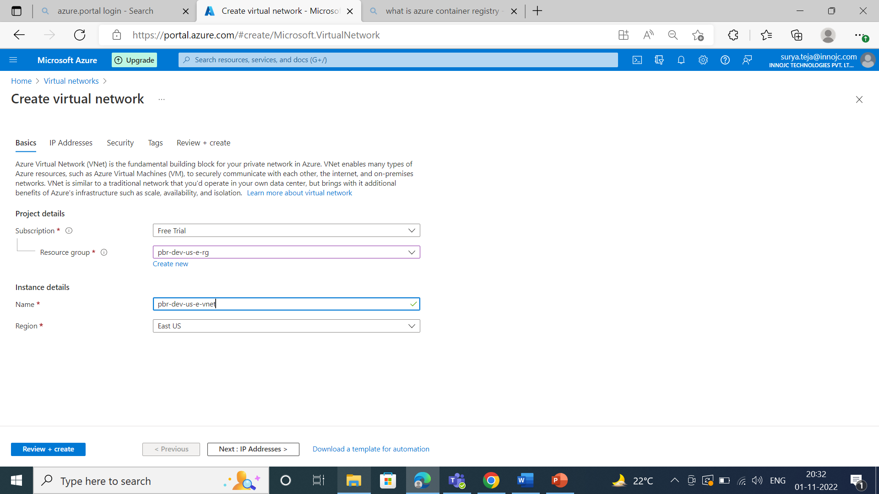

Slide 8
Now we are creating ip address and after that we have to create subnet so,
If we want to launch the virtual network we have to create default subnet.
Subnet decides the range of the ip address in a virtual network.
Creation of vnet is the one time activity so we have to take maximum
number of ip address i.e /16 so we get 65536 ip addresses.

Slide 9
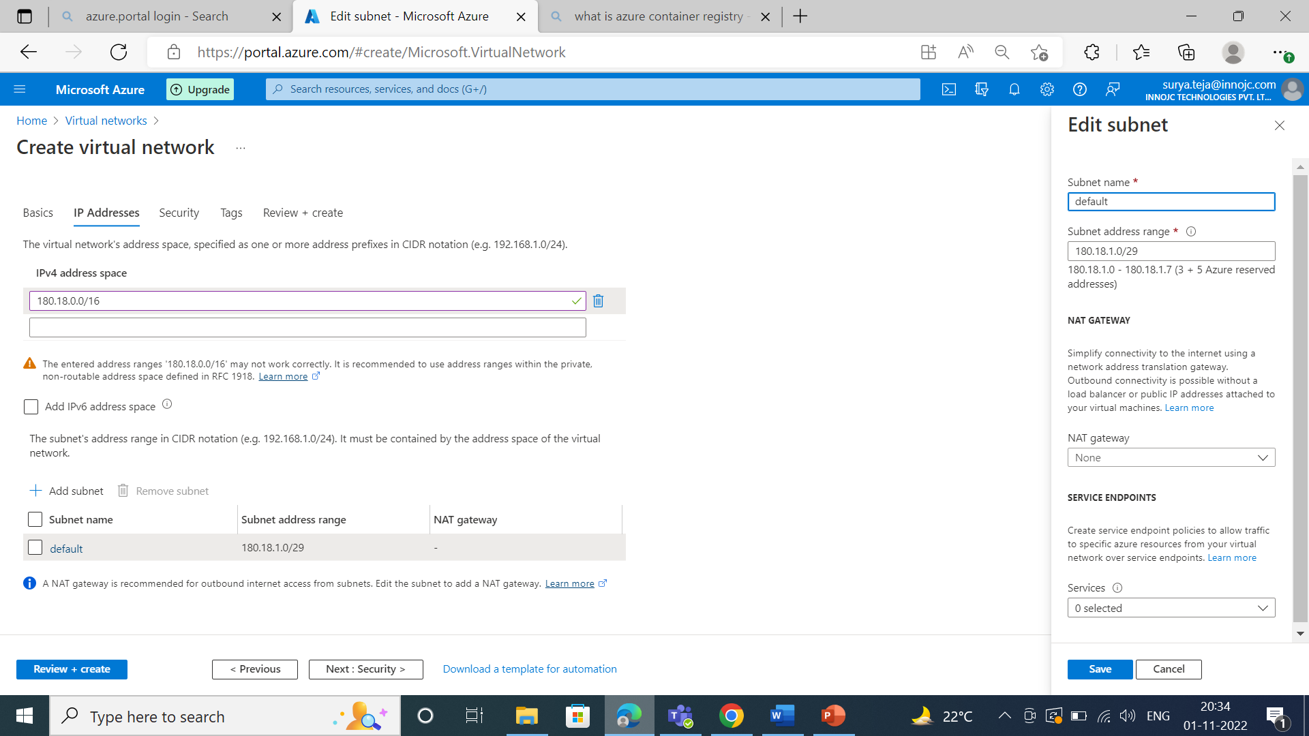

Slide 10
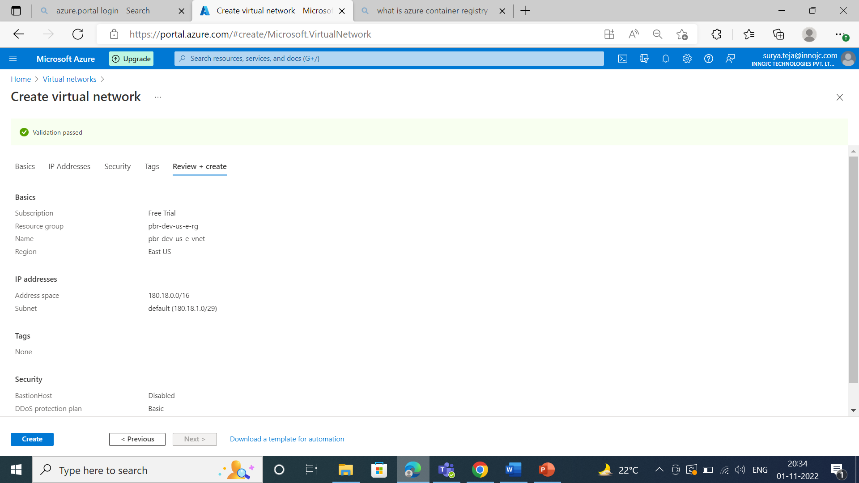

Slide 11
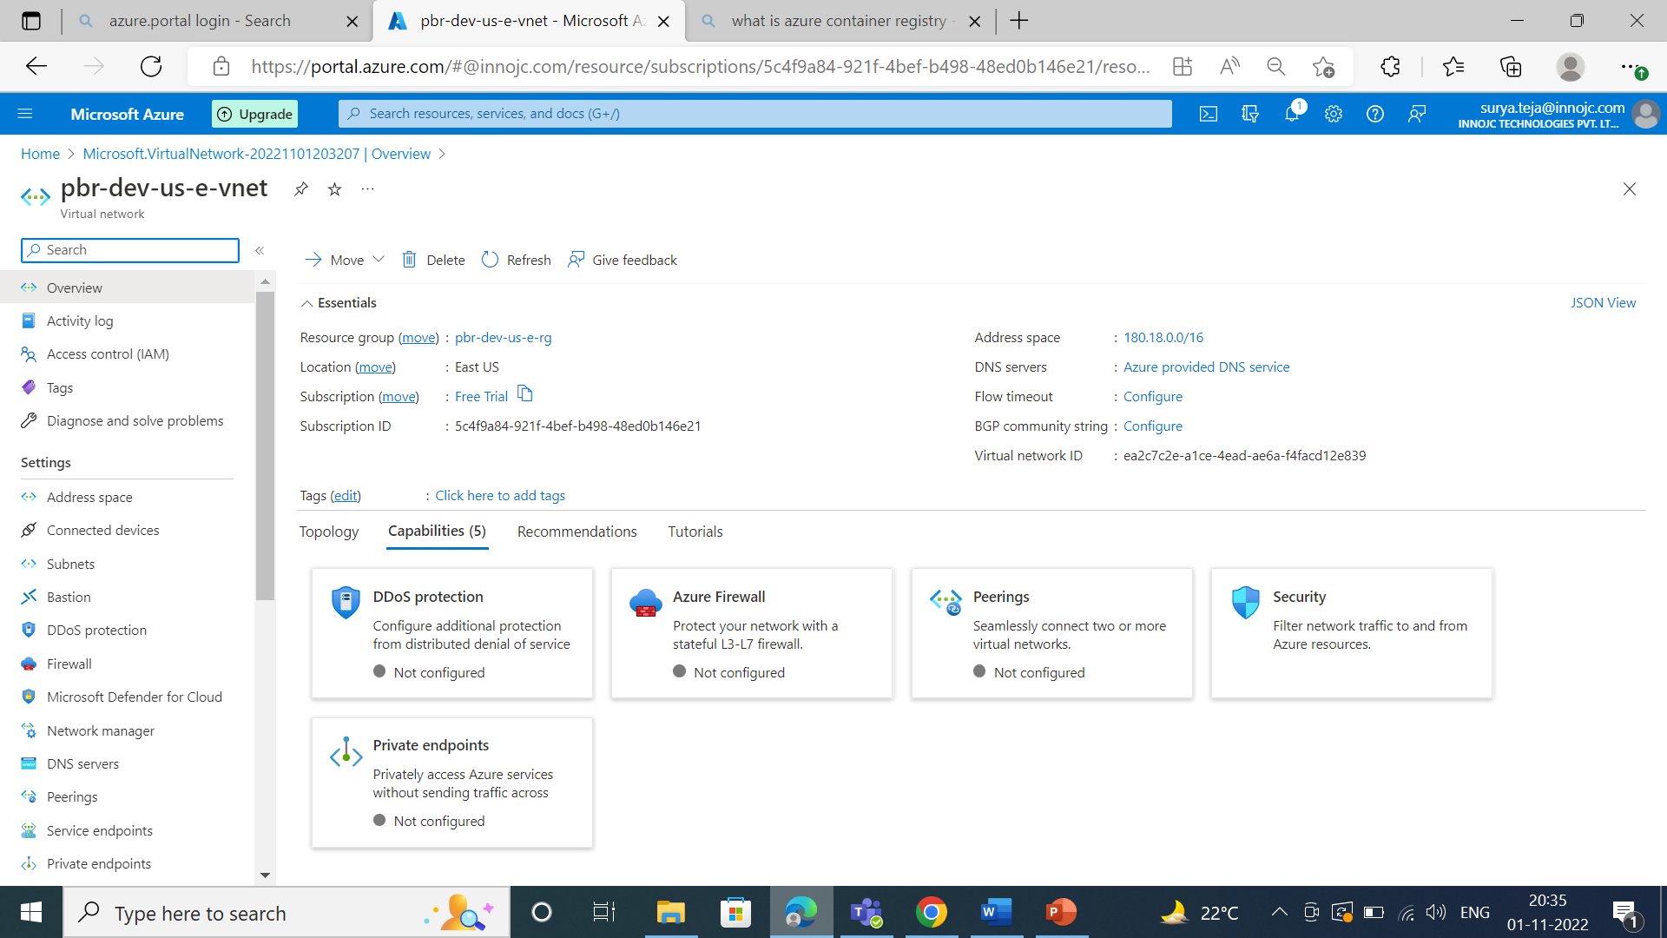

Slide 12
Virtual machine:
Virtual machine belong to the infrastructure as a service model where it gives the
Flexibility of virtualization without buying and maintain the physical hardware.
. Again we are creating the subnet to launch Vm and to decide the range of an ip
address.

Slide 13
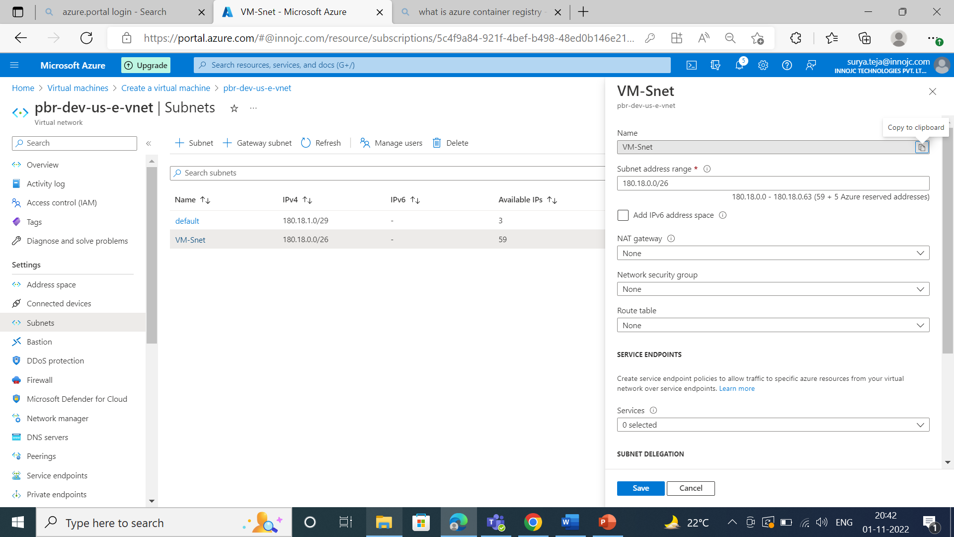

Slide 14
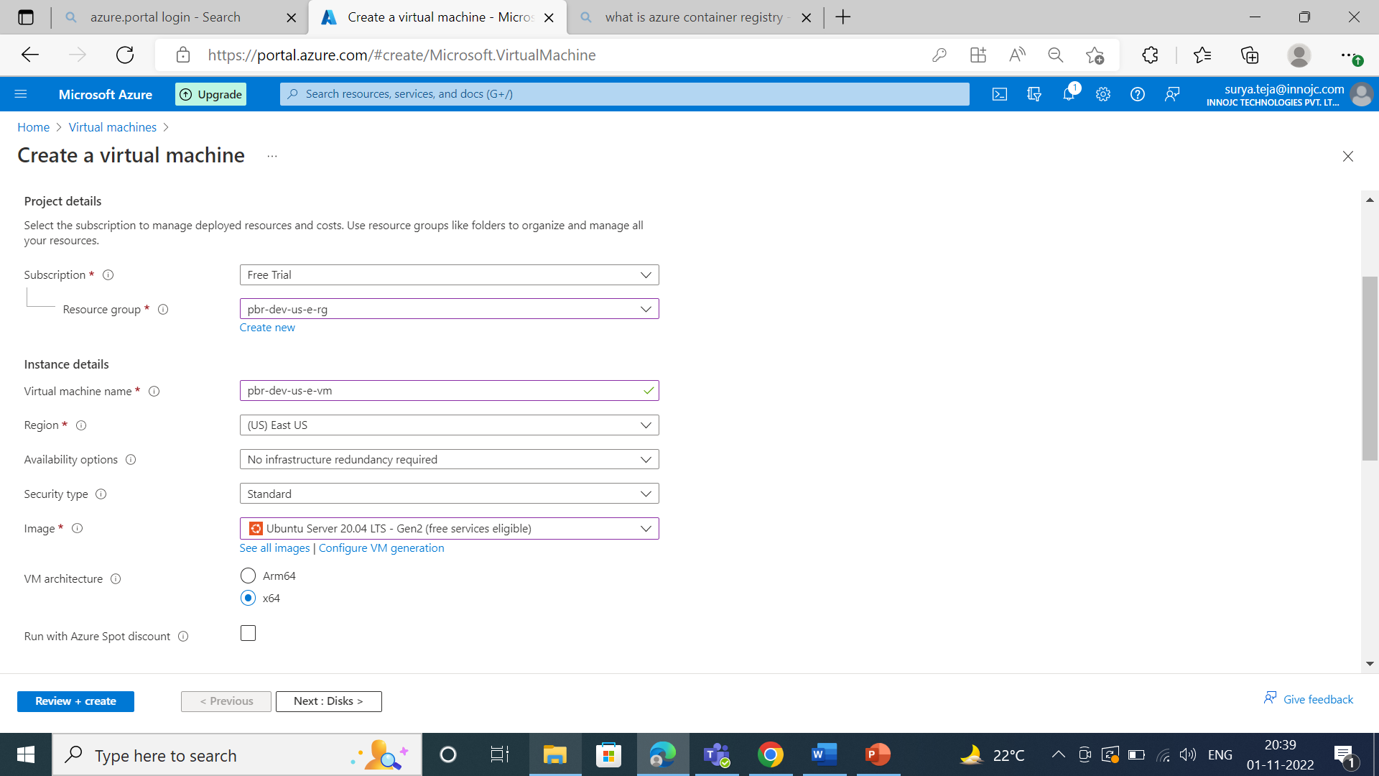

Slide 15
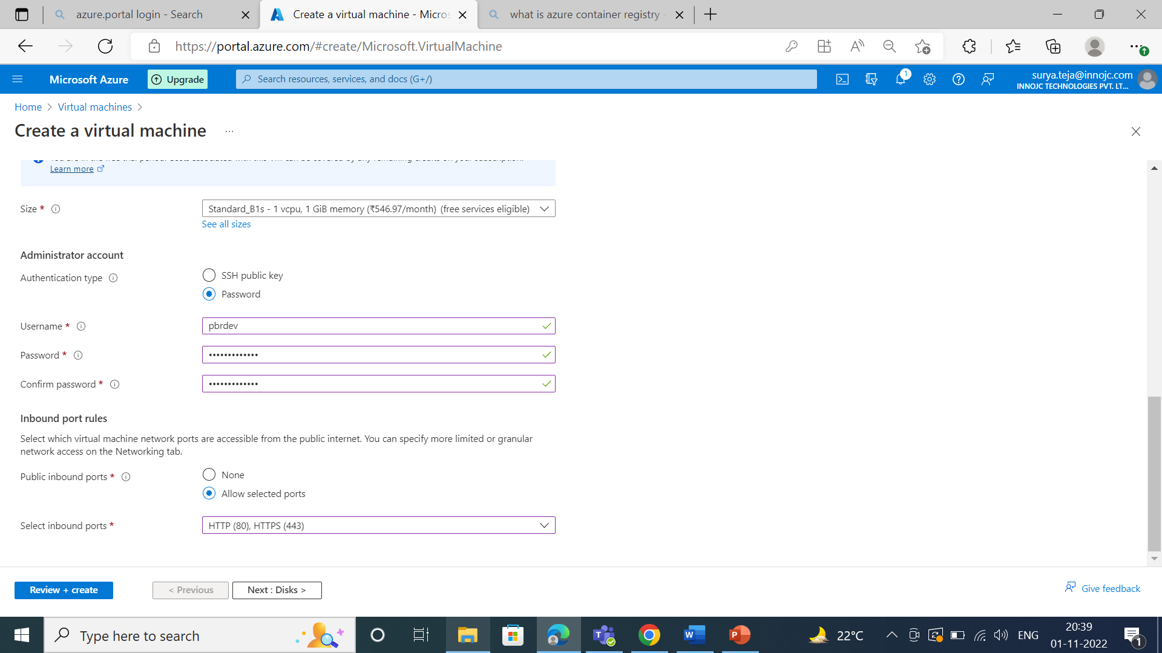

Slide 16
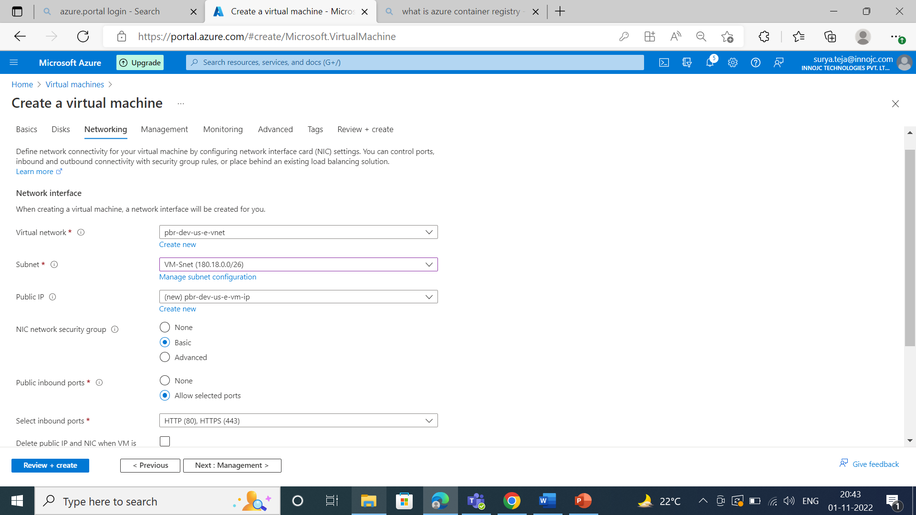

Slide 17
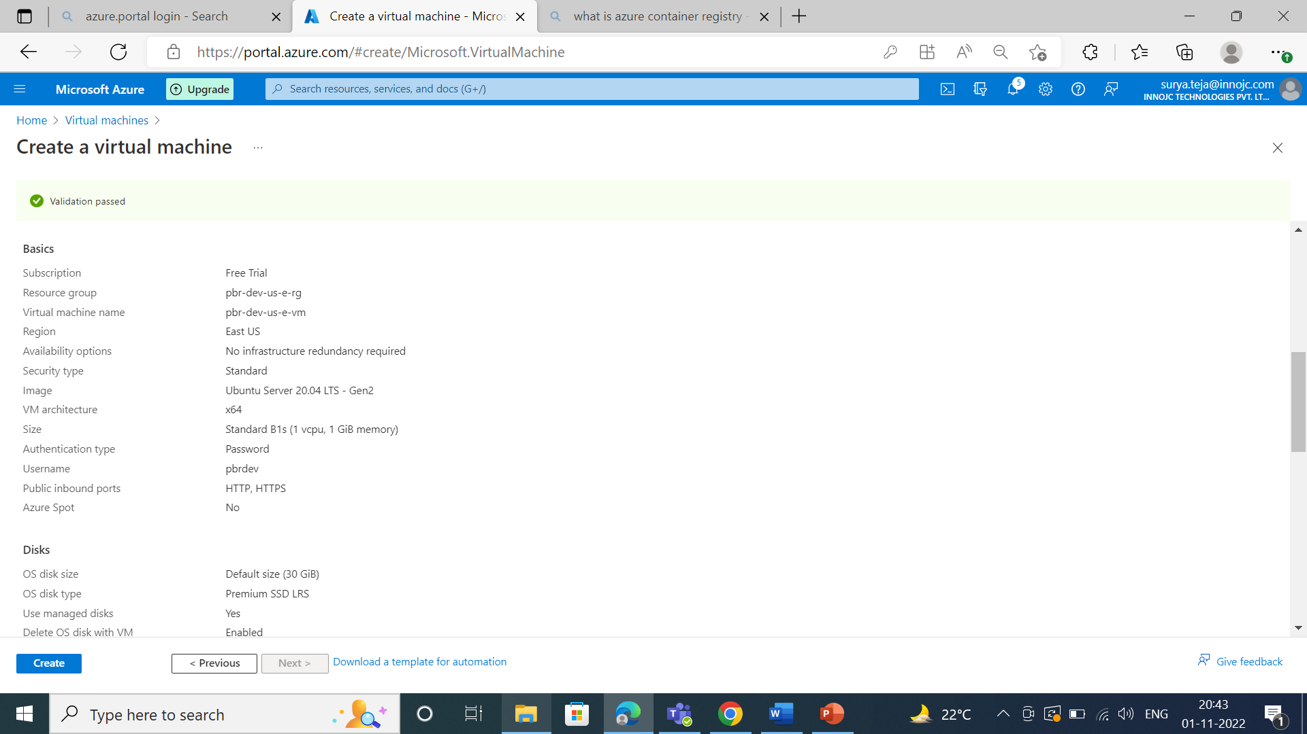

Slide 18
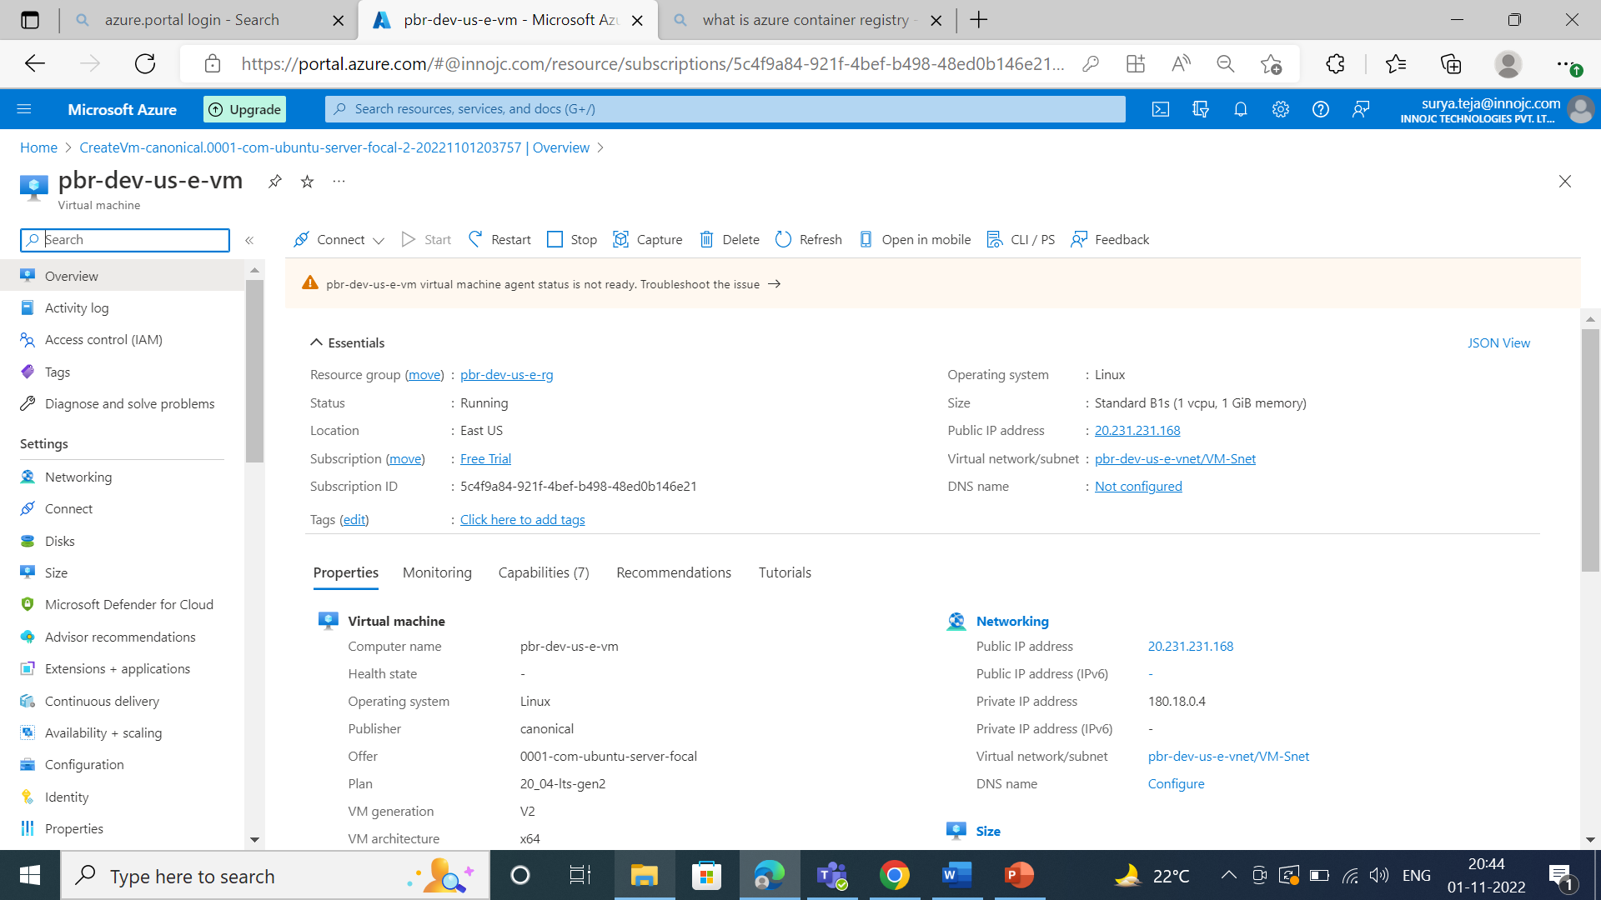

Slide 19

Now we are connecting the Bastion to vm because it directlty access rights to the vm and also bastion is the more secure and effective mode to vm. For bastion also we are creating the subnet.

Slide 20
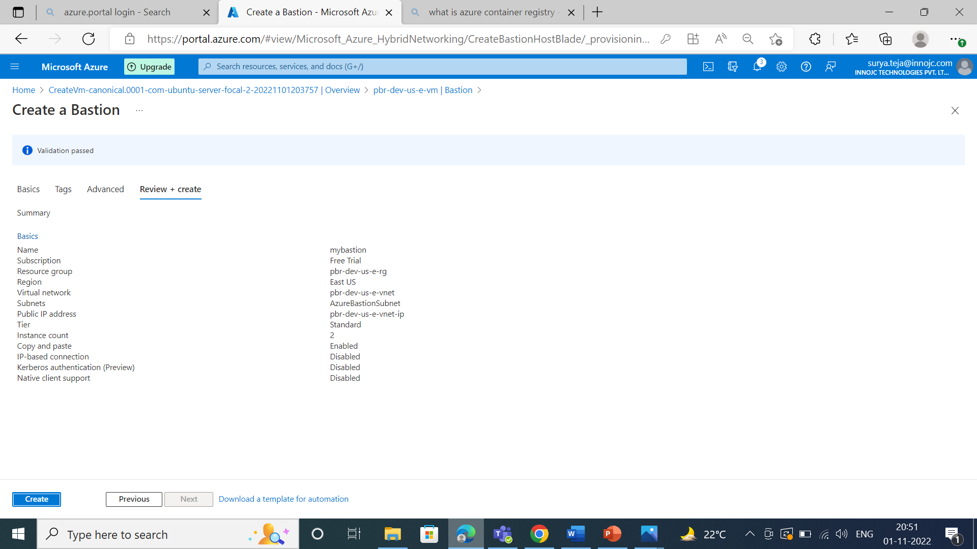

Slide 21
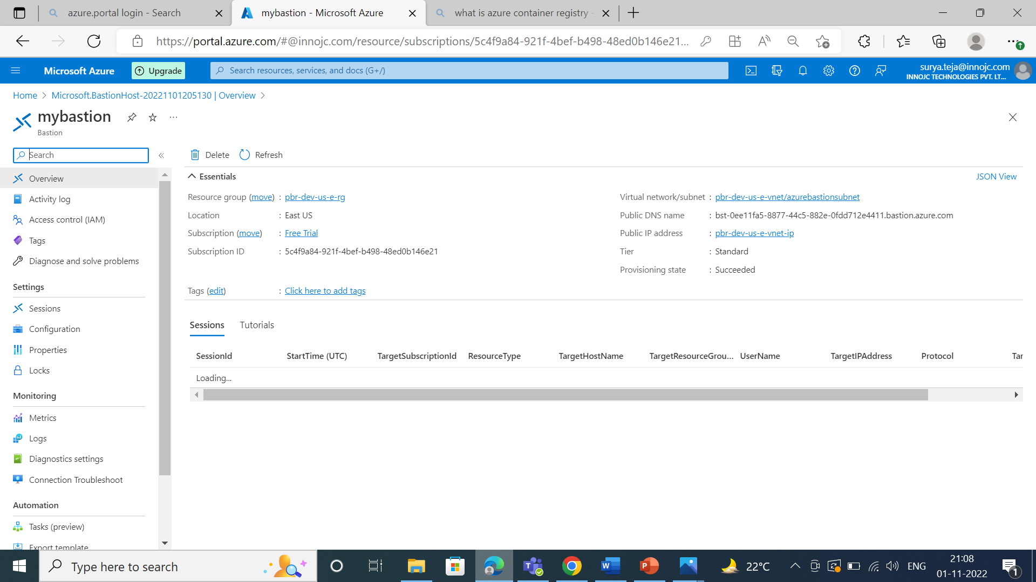

Slide 22
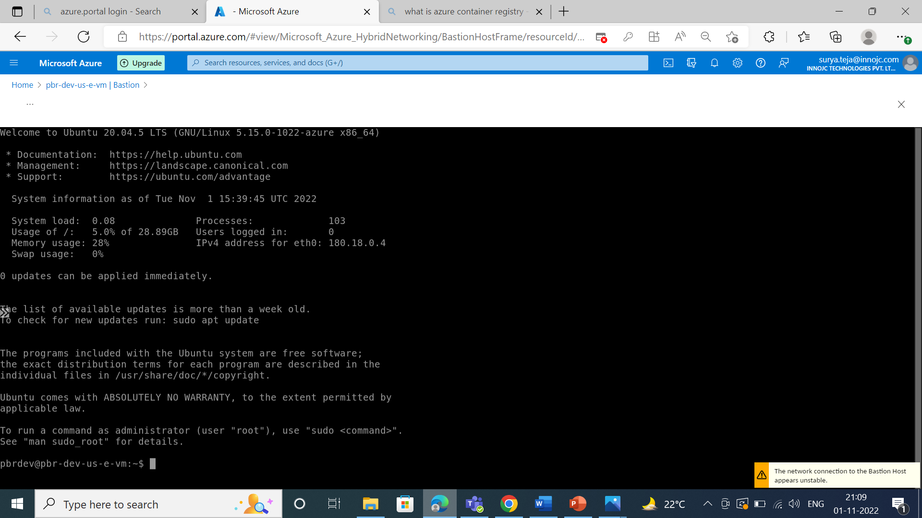

Slide 23
Network security group:
Providing security for virtual network.
Providing security for subnets in virtual network.

Slide 24
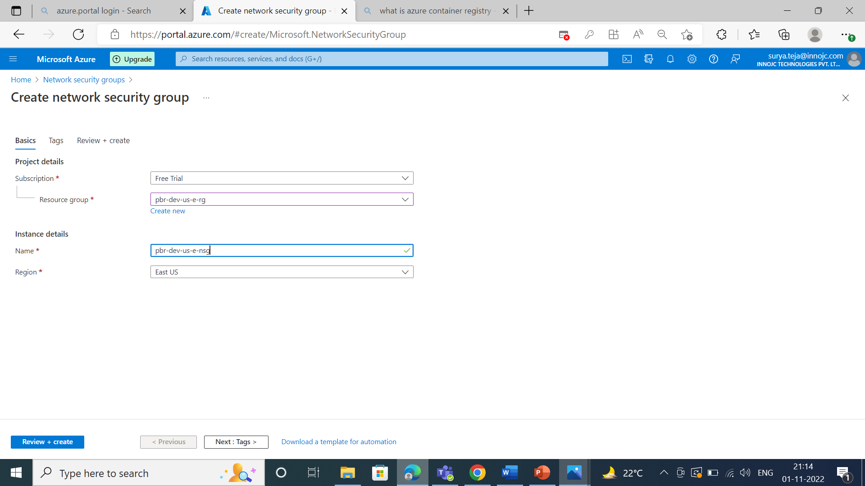

Slide 25
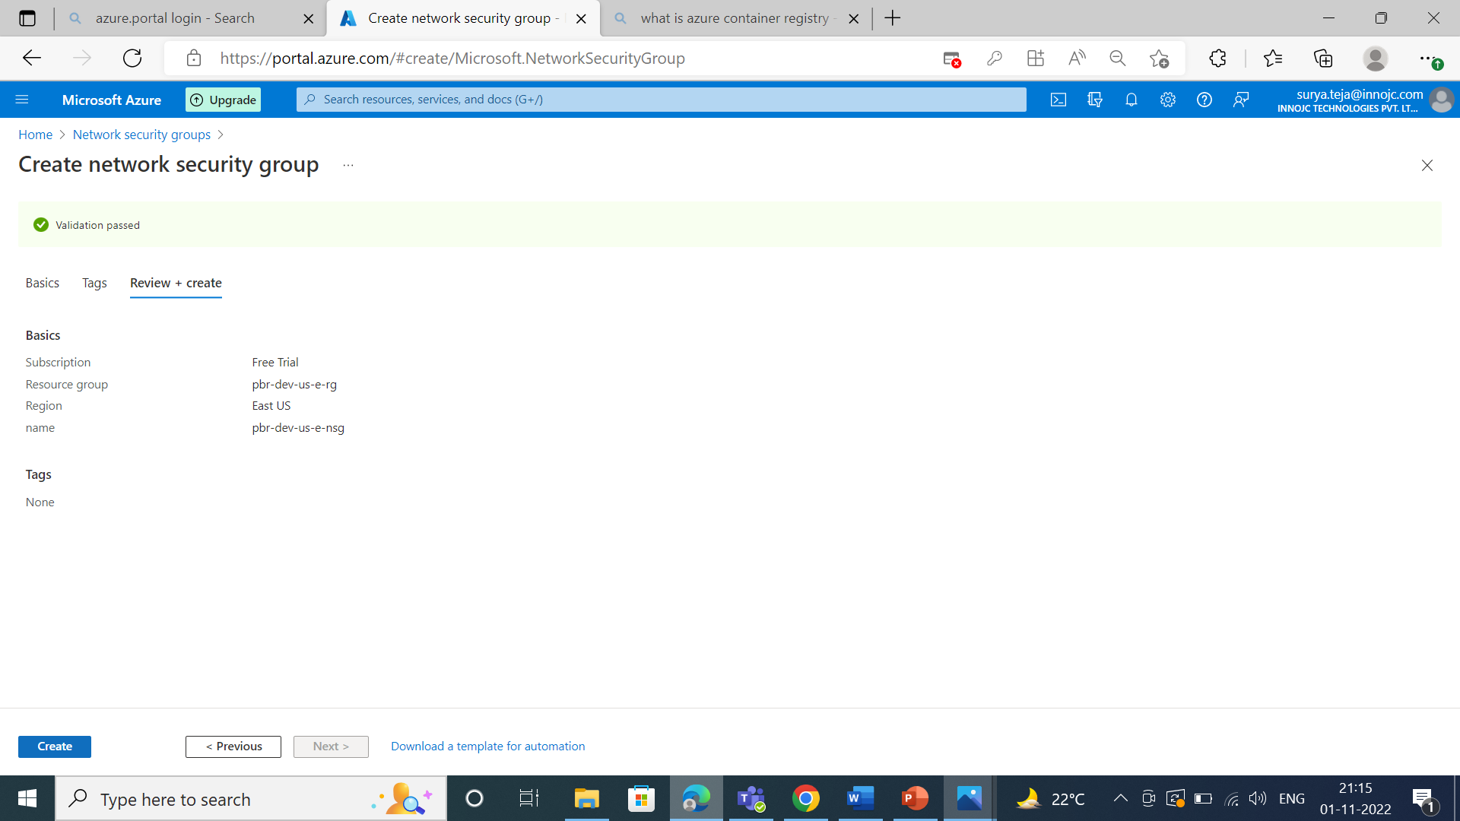

Slide 26
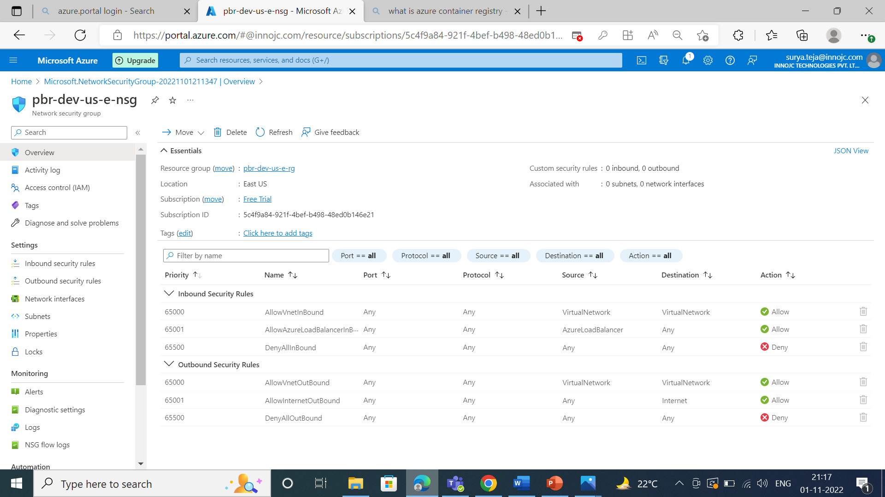

Slide 27
When we launch NSG we will get by default two rules they are,
Inbond security rule.
outbond security rule.
In inbond security rule always destination will be our virtual network.
In outbond security rule always source will be our virtual network.
Inbond security is nothing but incoming from out side network to our network.
Outbond security is nothing but from our virtual network to out side network.

Slide 28
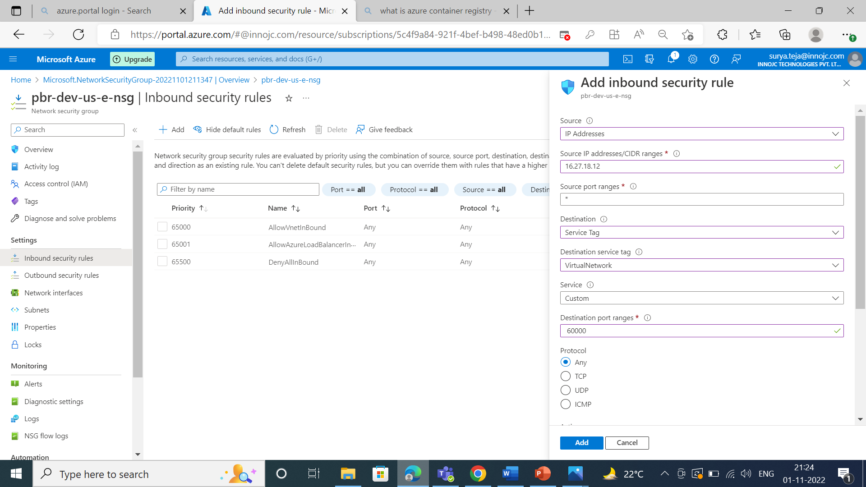
We are adding the inbond security rule,

Slide 29
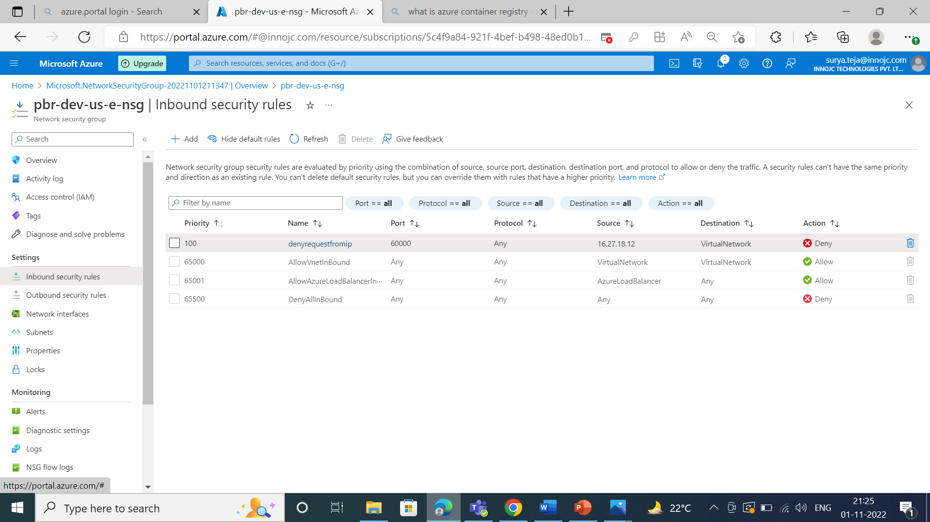

Slide 30
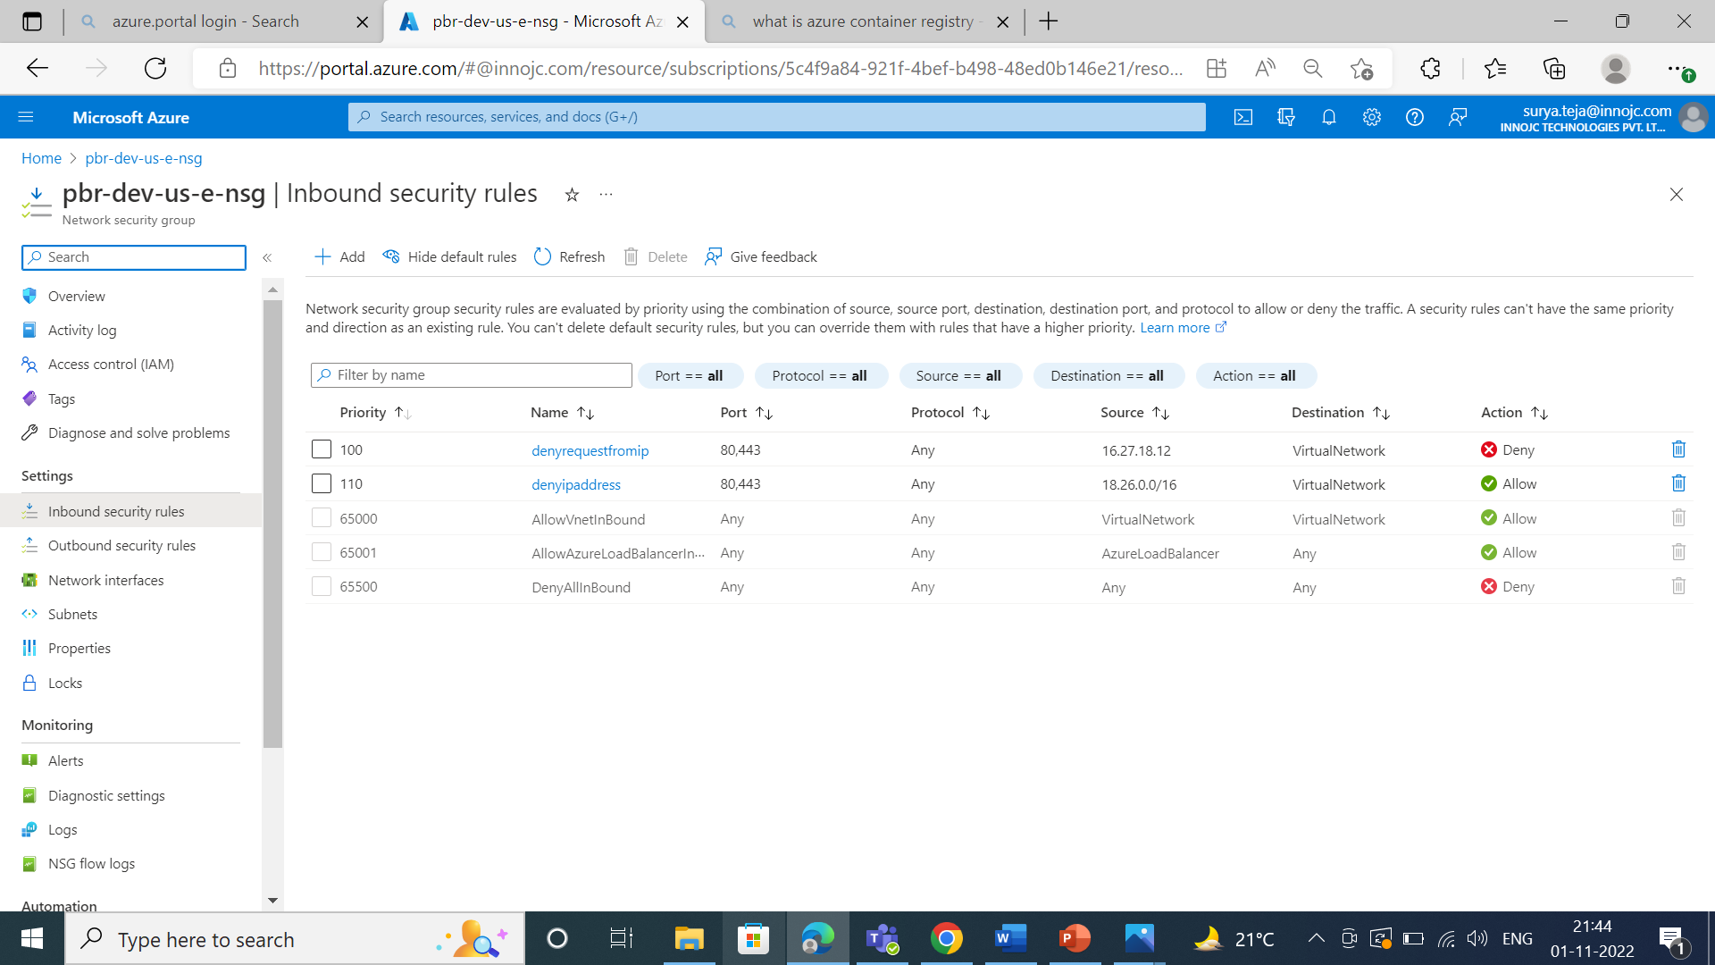

Slide 31
Azure container registry:
It is used to place the image or to maintain the image in public cloud.
In real time we are going to place the images in repositors.

Slide 32
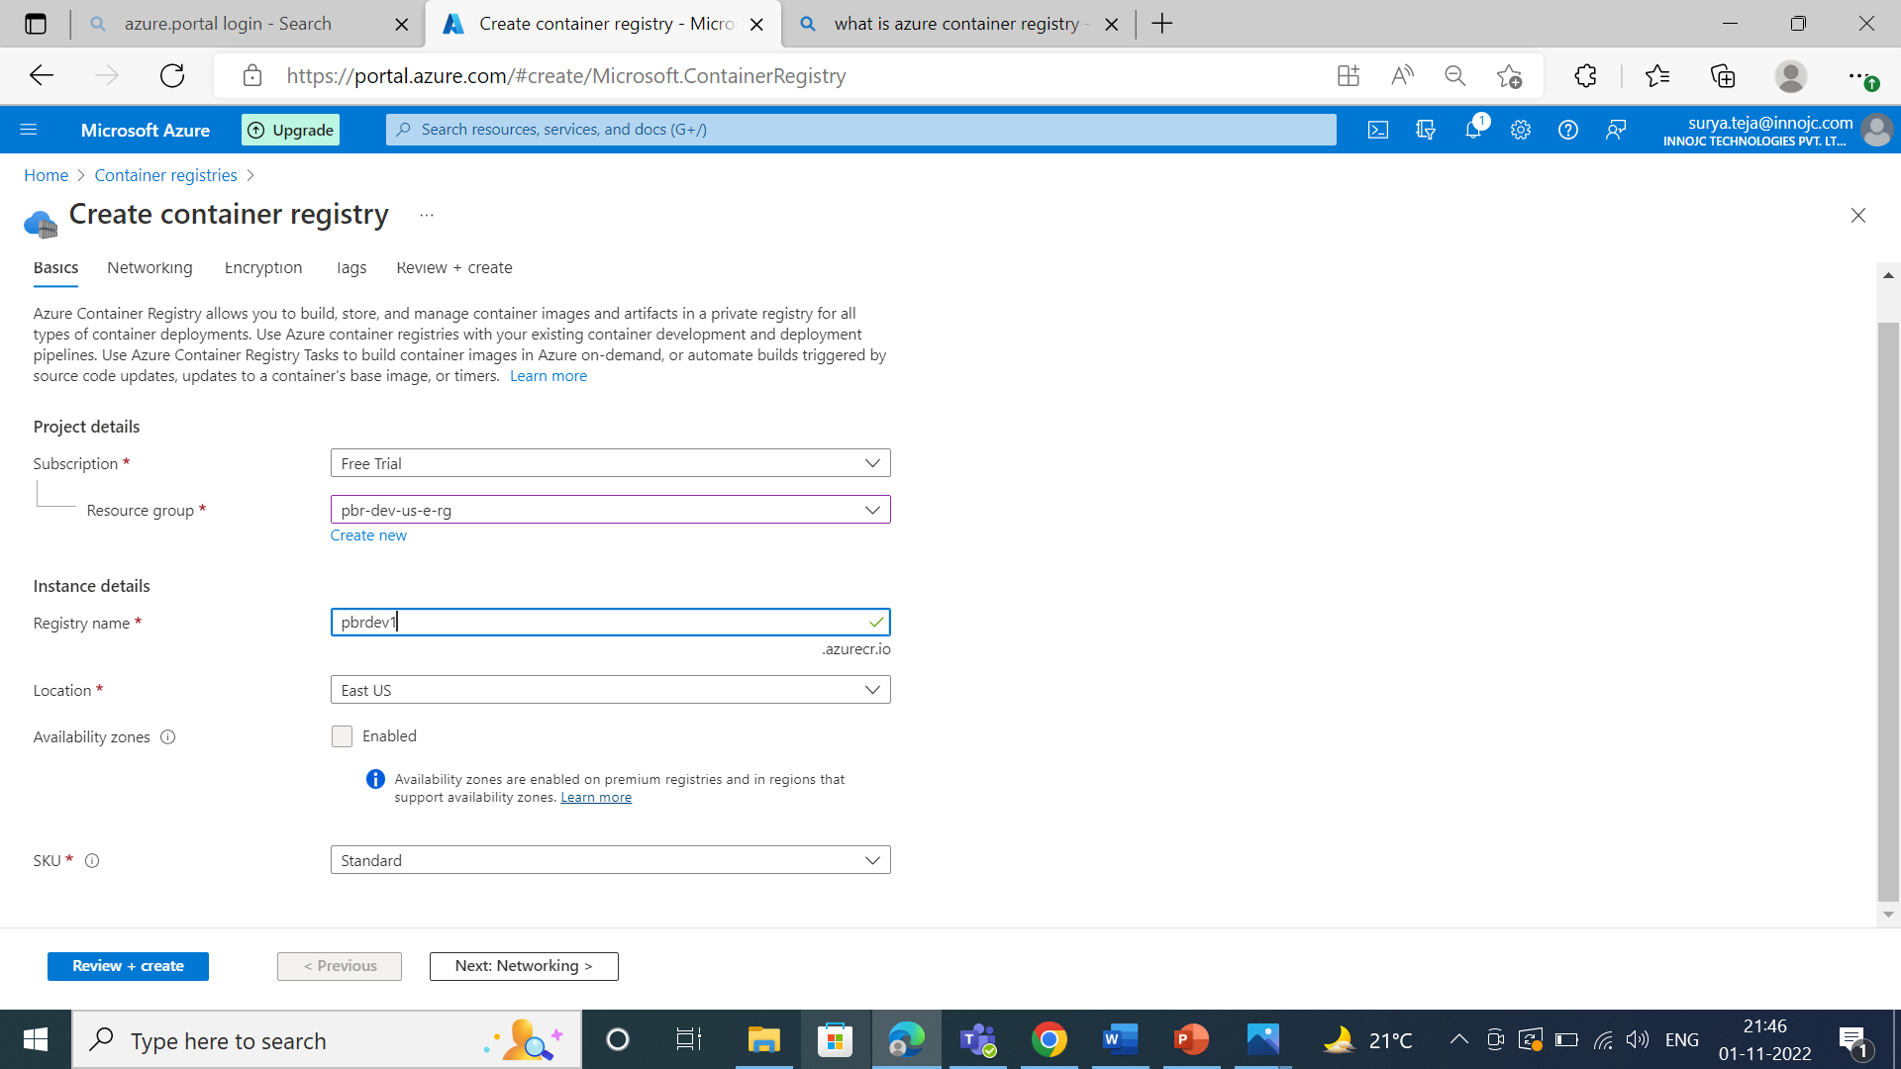

Slide 33
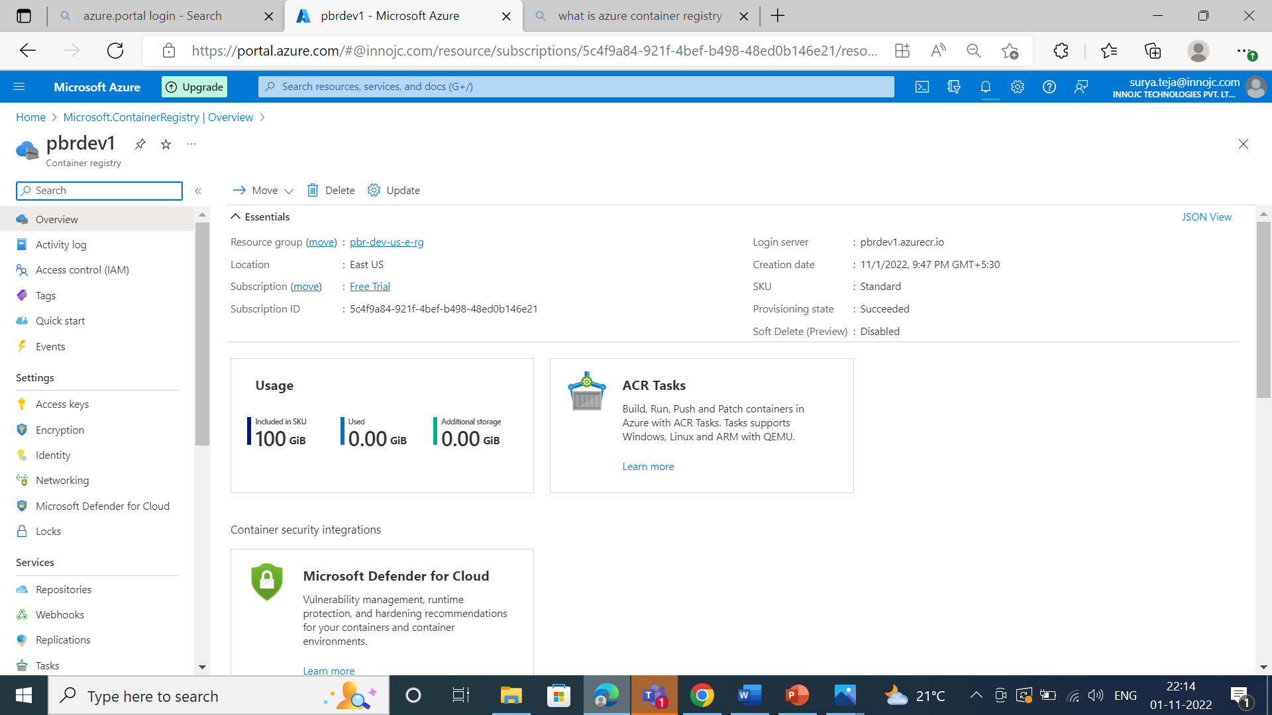

Slide 34
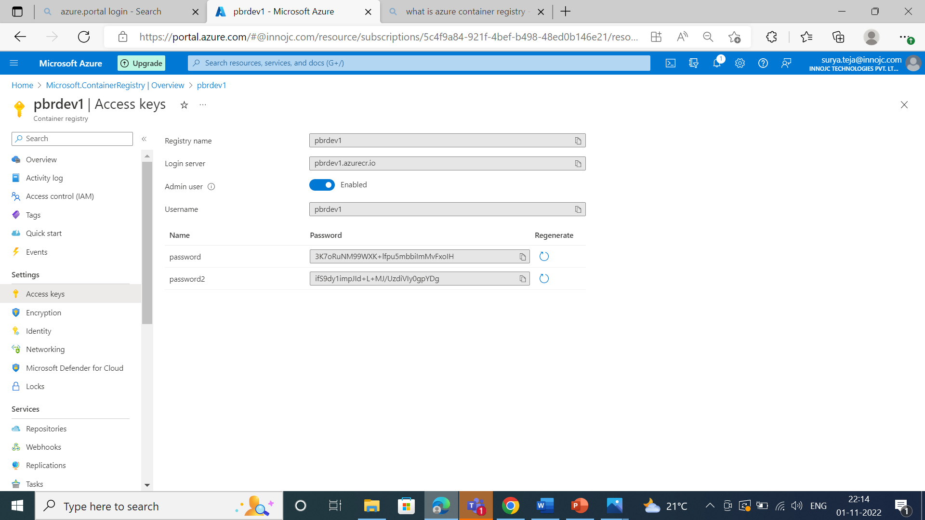
In access keys we are getting ACR user name and password and we are configuring in the pipe line .

Slide 35
Azure Kubernetes services:
To deploy our micro services.
Instead of maintaining huge application we are maintaining it into multiple manageable services.(micro services)
We are creating the AKS subnet i.e, how many ips are need to assign in AKS cluster and it is depends upon the micro services we deploy.

Slide 36
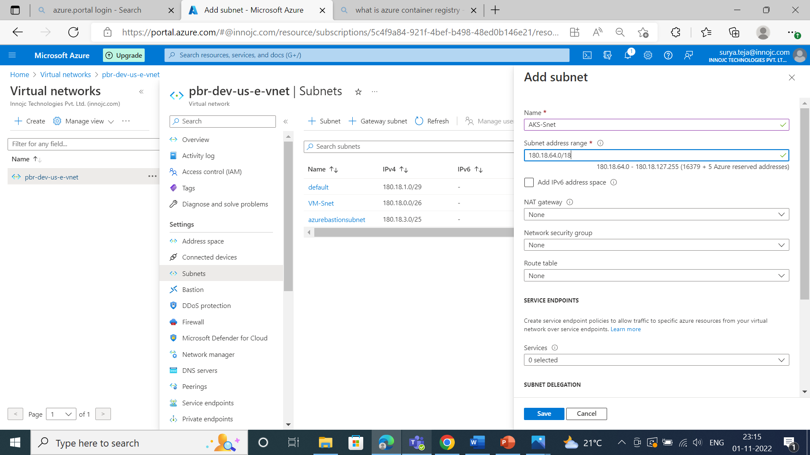

Slide 37
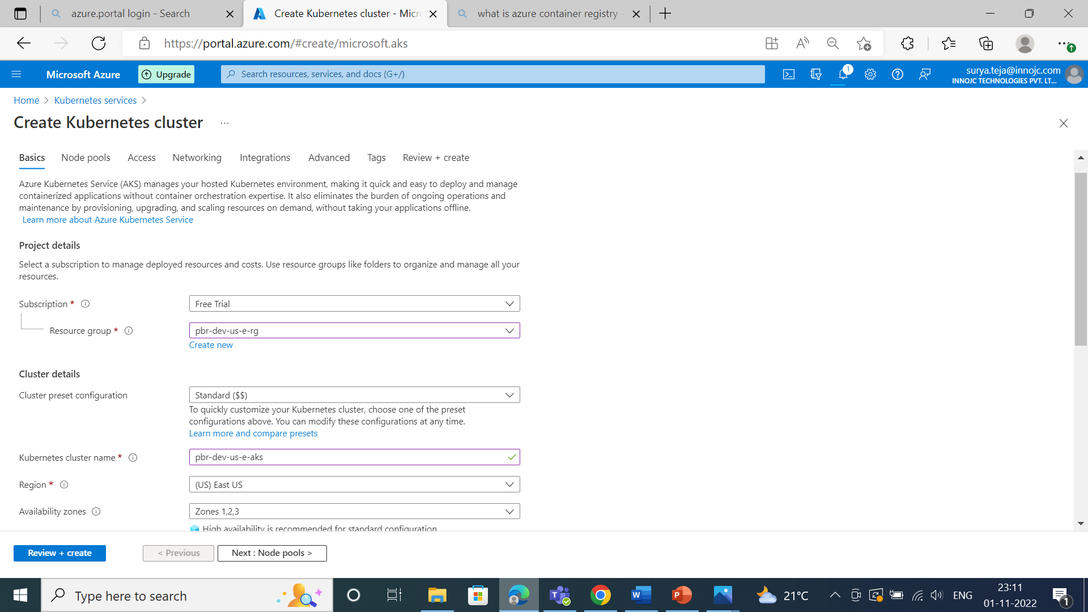

Slide 38
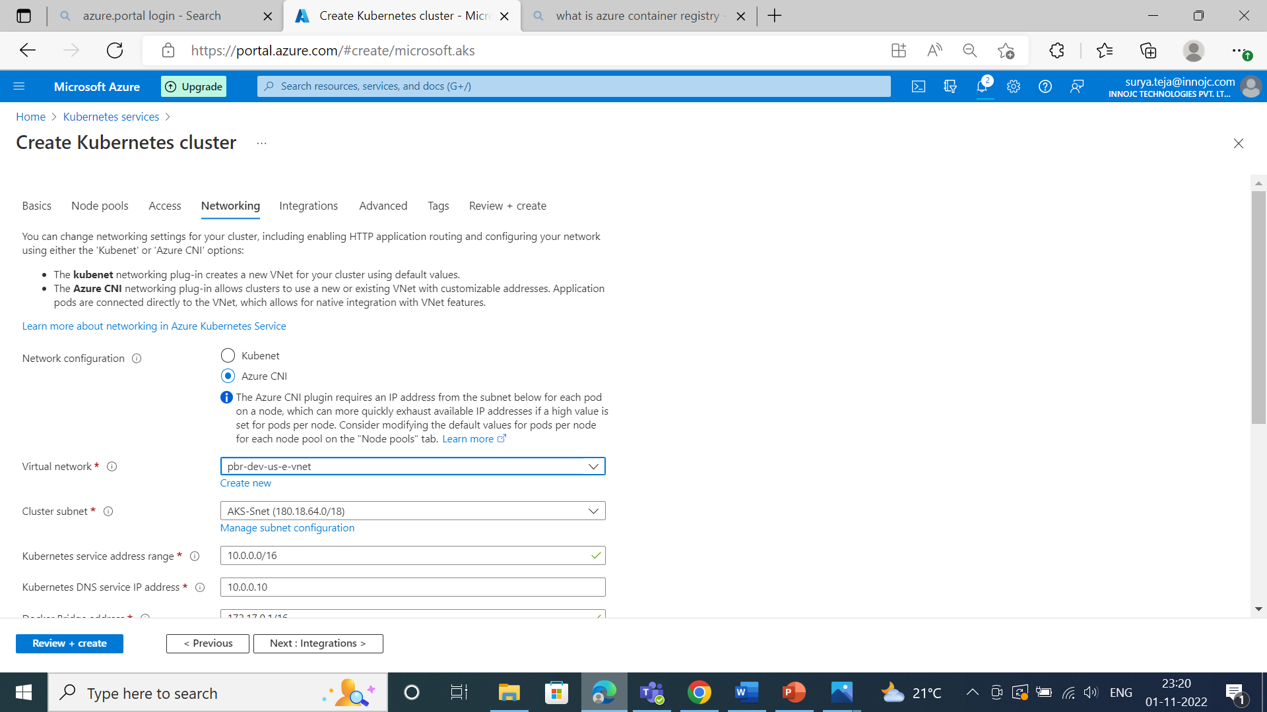

Slide 39
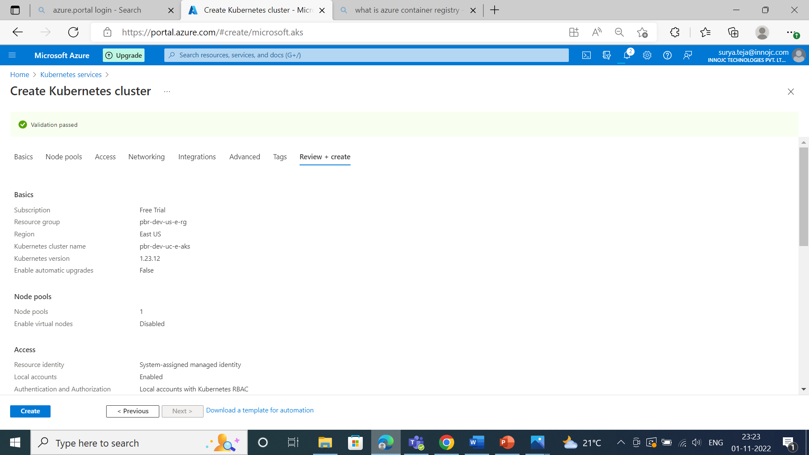

Slide 40
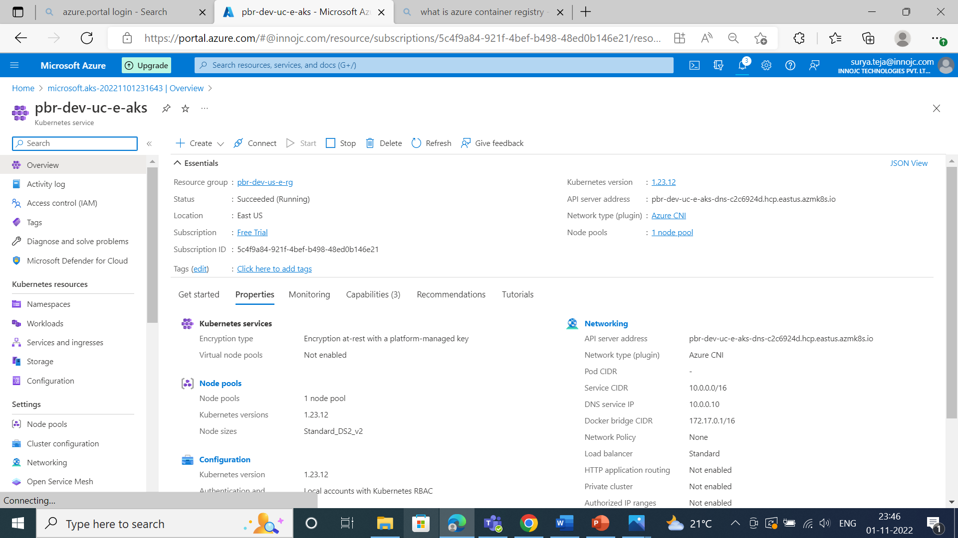

Slide 41
ACR(azure container registry):
Azure container registry is nothing but we place image or to maintain the image in public cloud.
In real time we are going to create repository and we are placing the image in the repository.
If we want to send the image from onprime to public cloud we have to install AZ CLI.
We need to provide access to the AKS subnet because to pick up the image and to deploy the service.

Slide 42
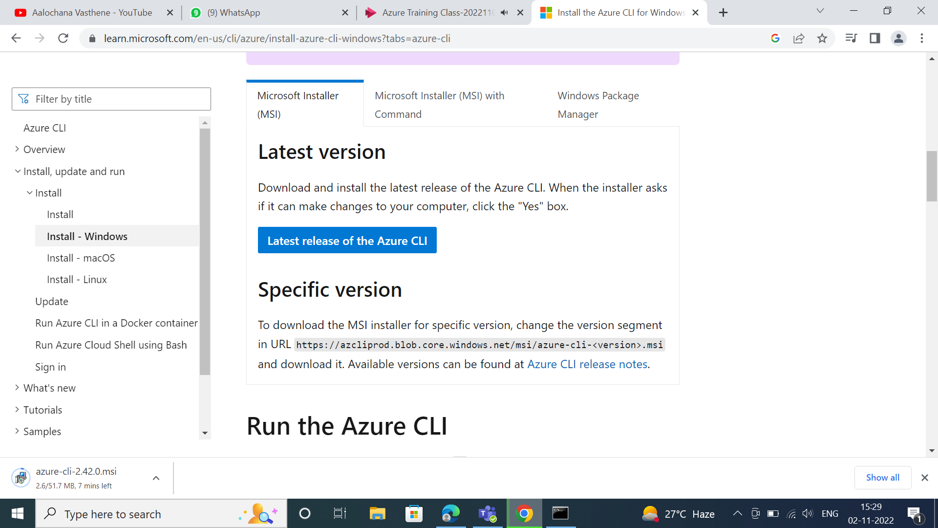
From google we can install the Azure CLI,

Slide 43
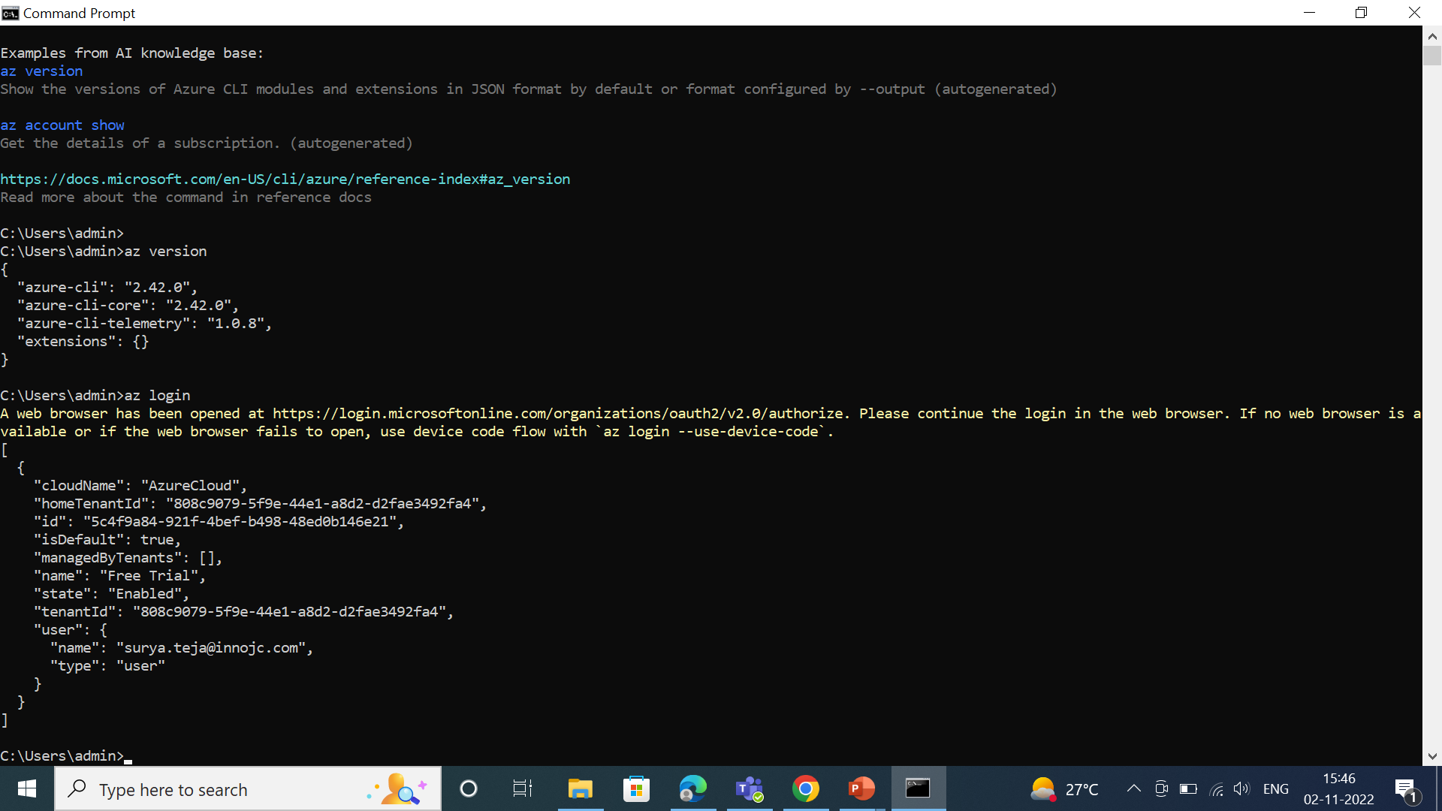
After installing the azure cli we have to verify,

Slide 44
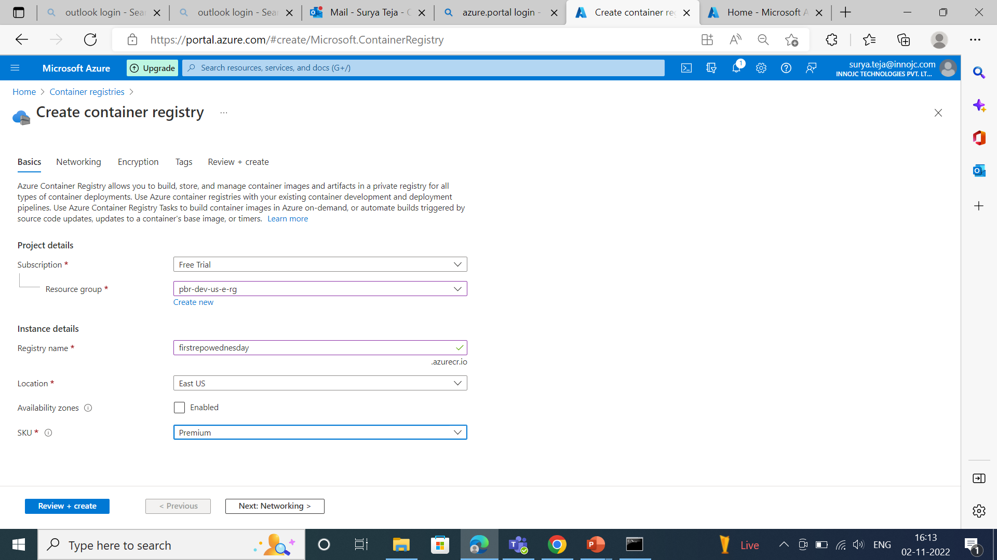
We are creating the azure container registry,

Slide 45
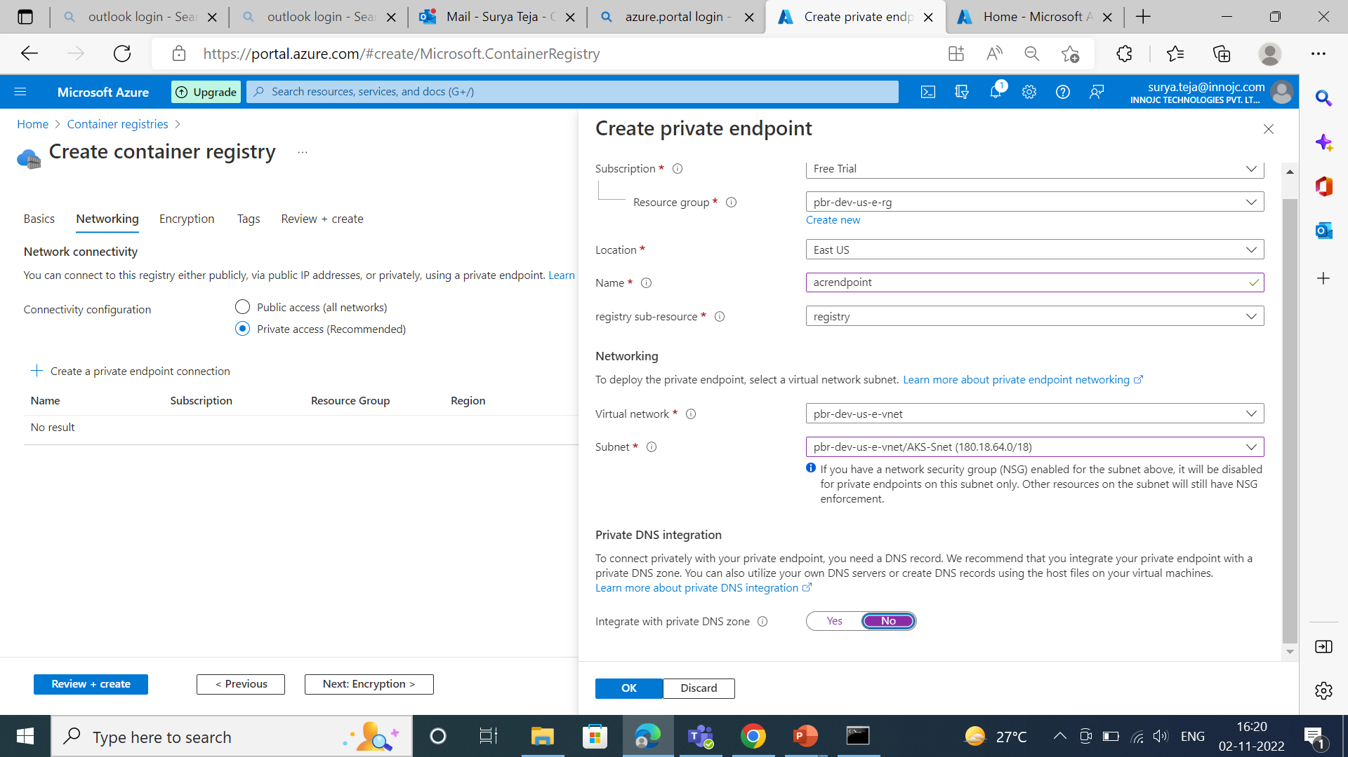

Slide 46
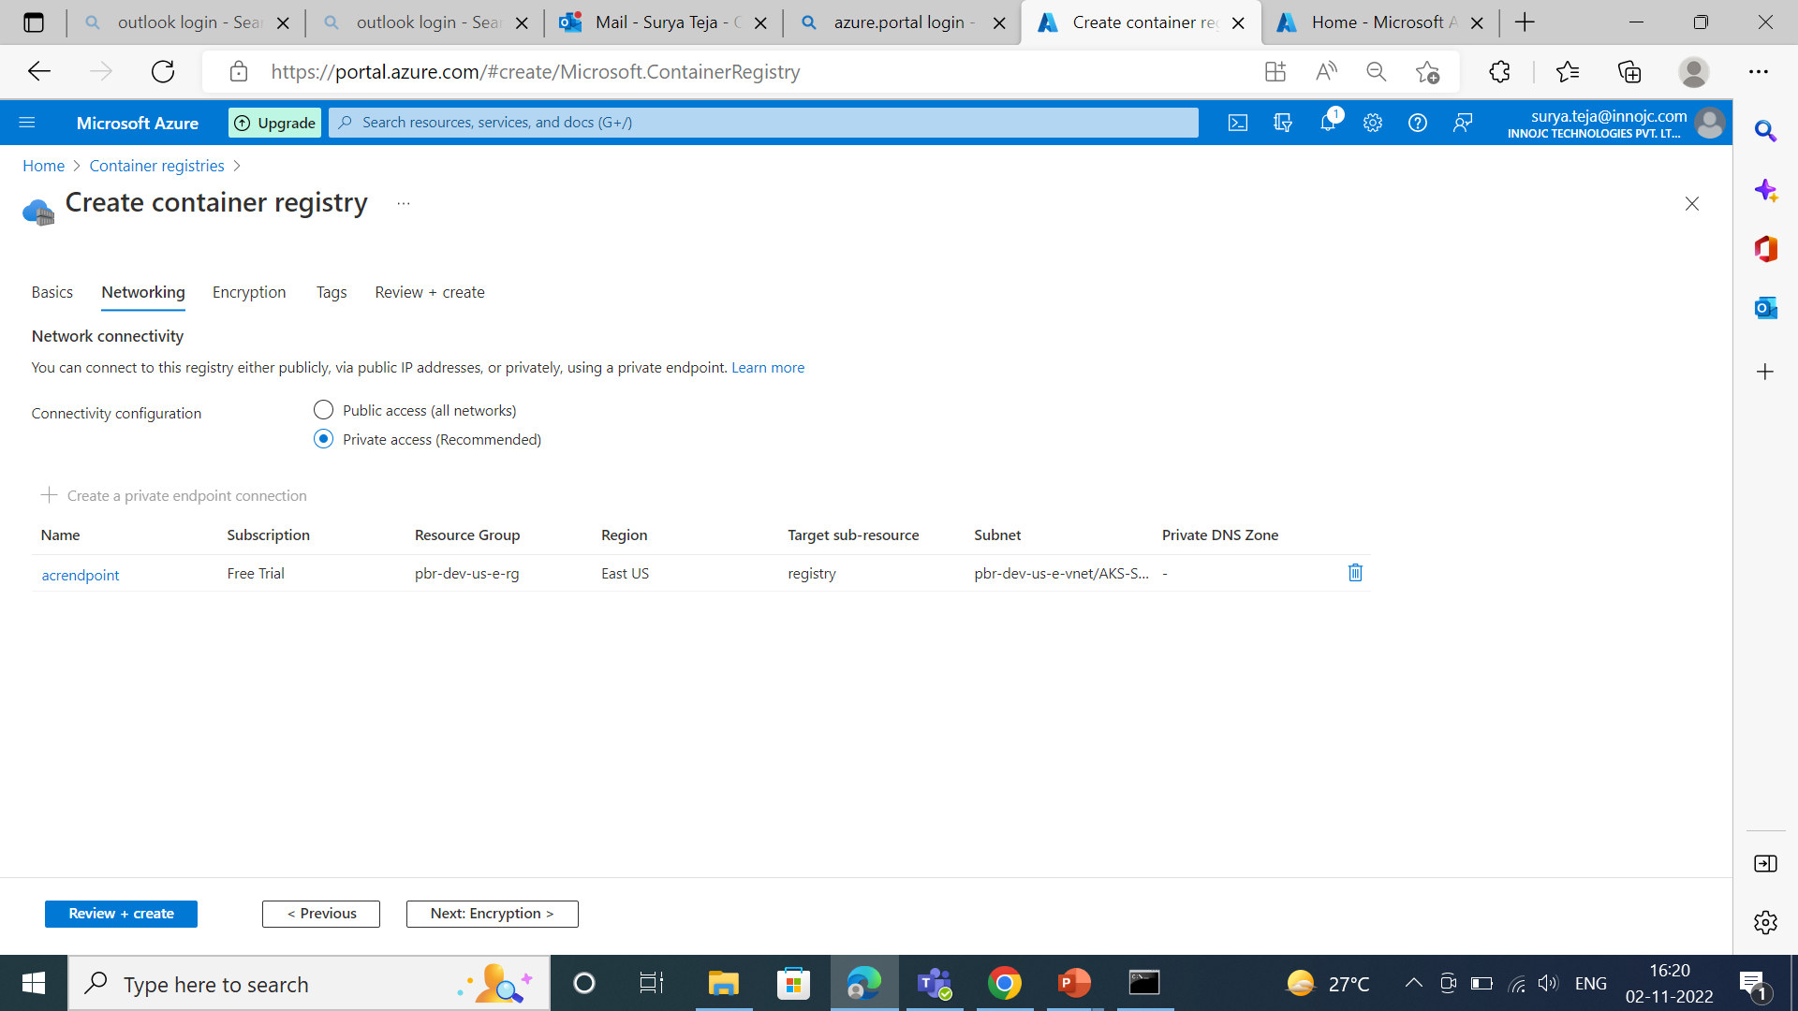

Slide 47
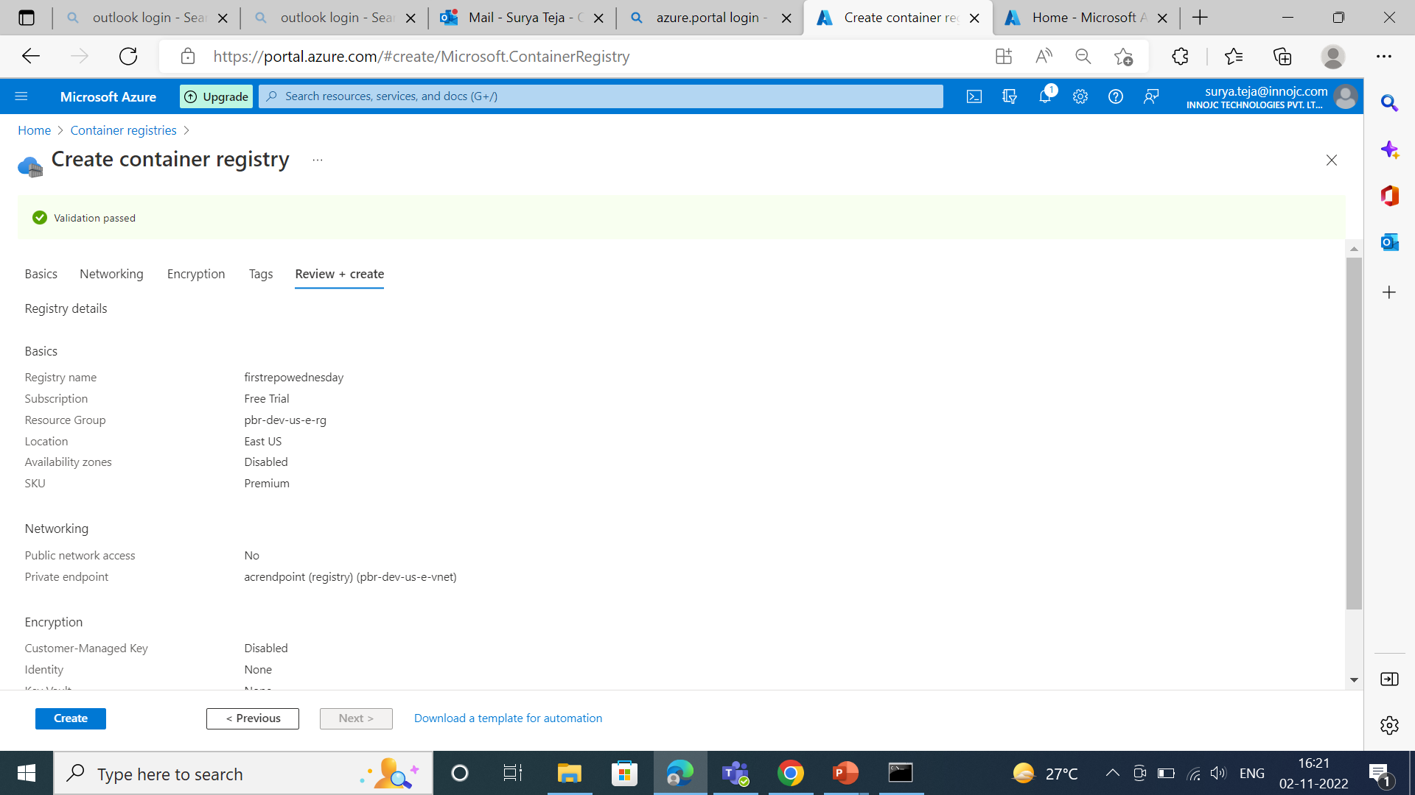

Slide 48
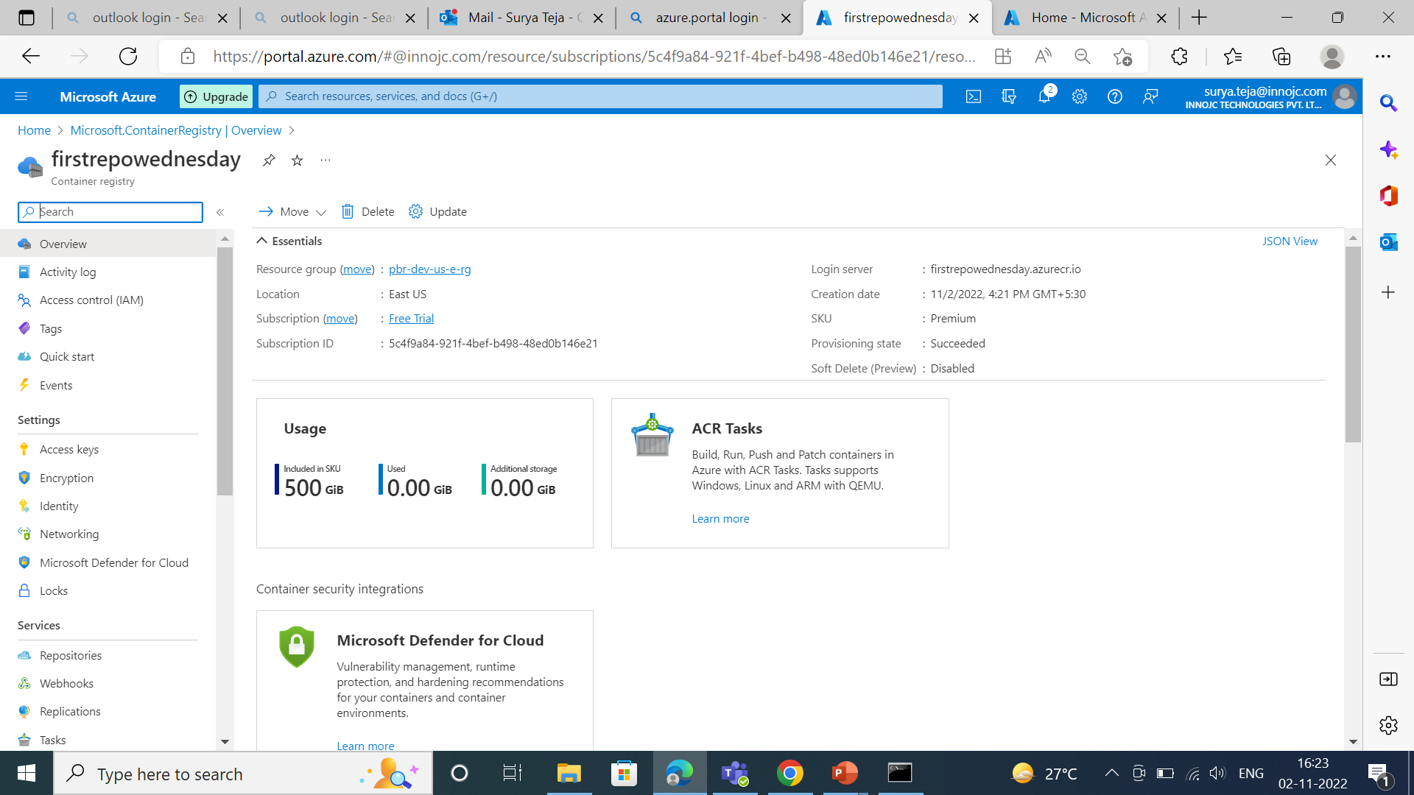

Slide 49
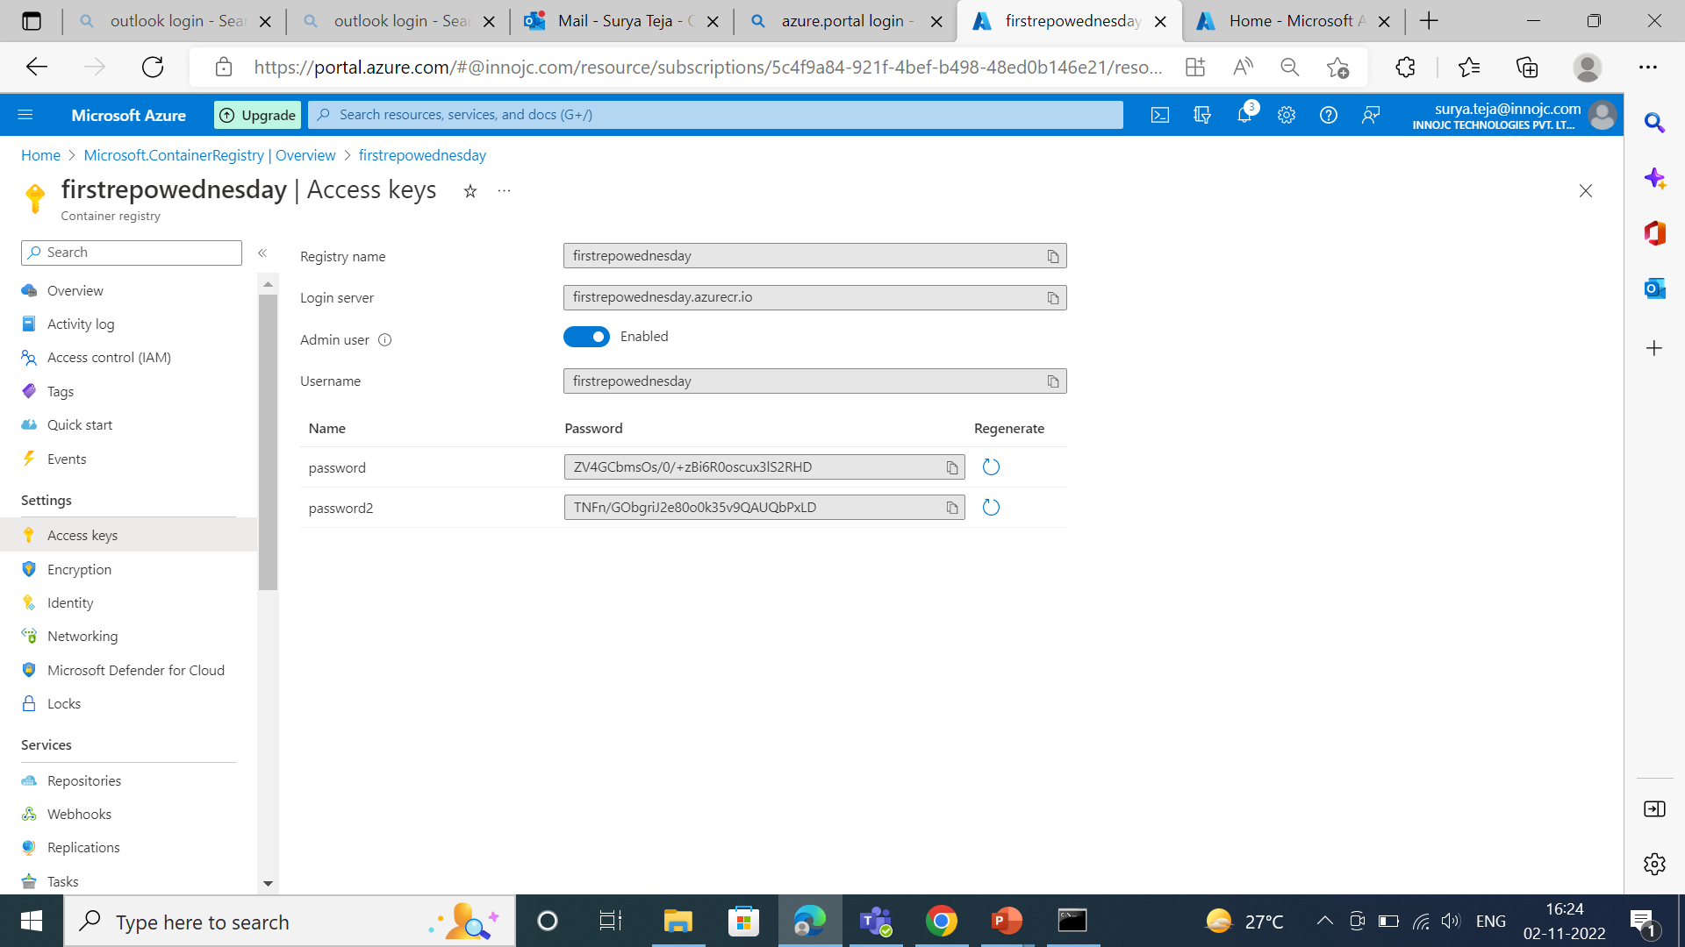
We have to enable the admin user then we will get te user name and password then we have to provide it to developer team we should not rearrange the password because we may fase the problem in pipeline.

Slide 50
Key vault :
With the help of key vault we can able to secure the sensible information.
Azure key vault is a cloud service that provides a secure store for secrets.
We can securely store keys,passwords,certificates,and other secrets.
We can create and manage key vault through azure portal.

Slide 51
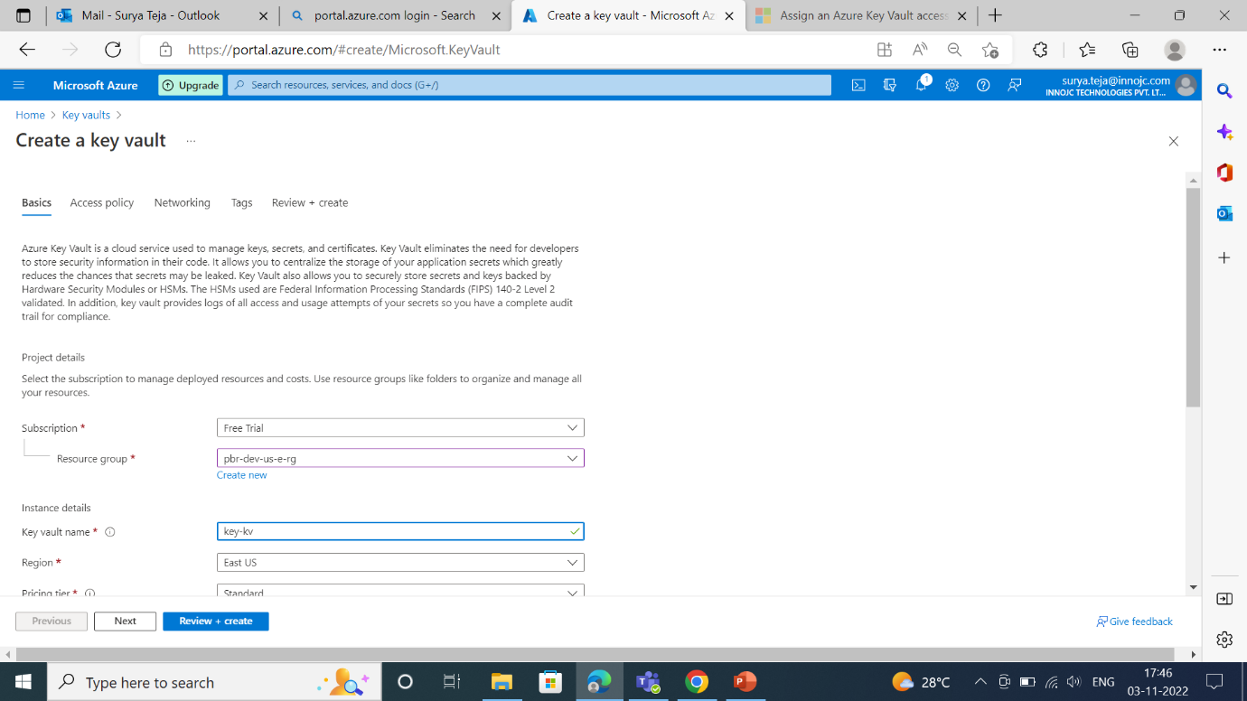

Slide 52
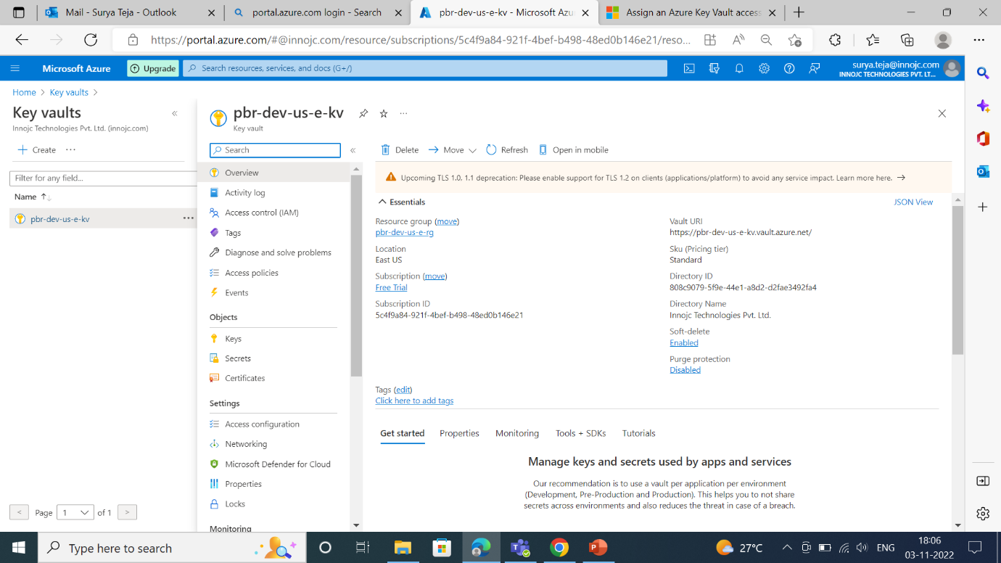

Slide 53
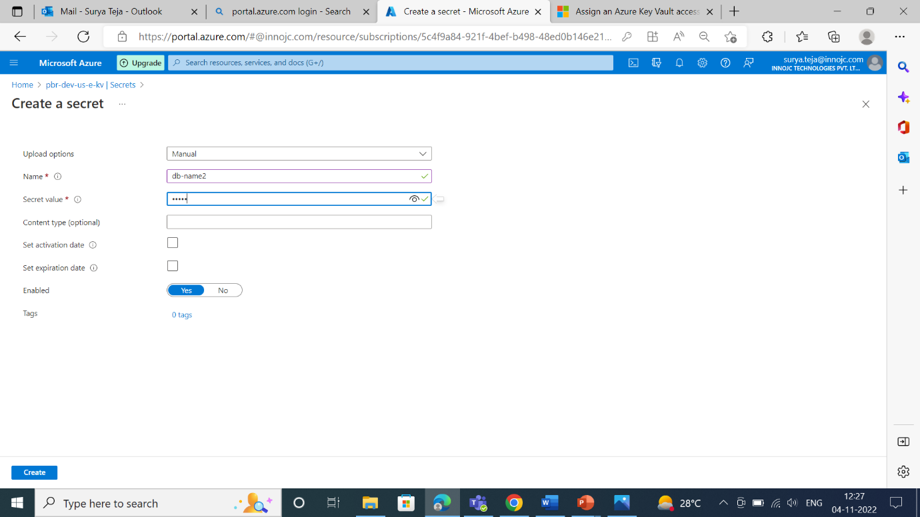
If we want to create the secret or place the sensitive information we can place in secret. We should not provide any activation date or expire date for secret.

Slide 54
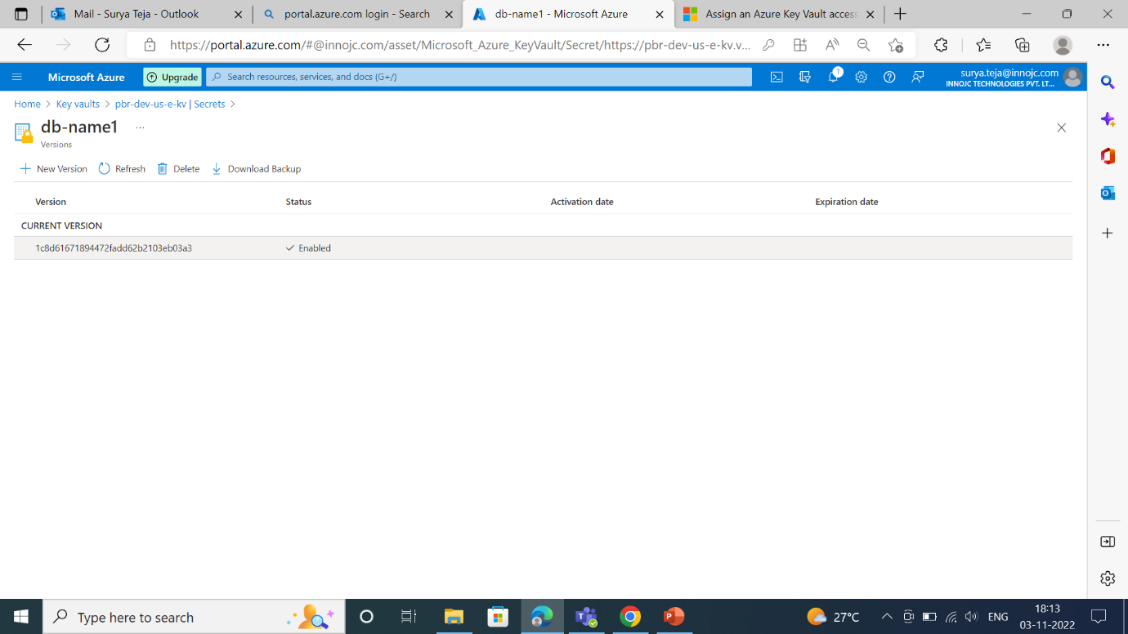

Slide 55
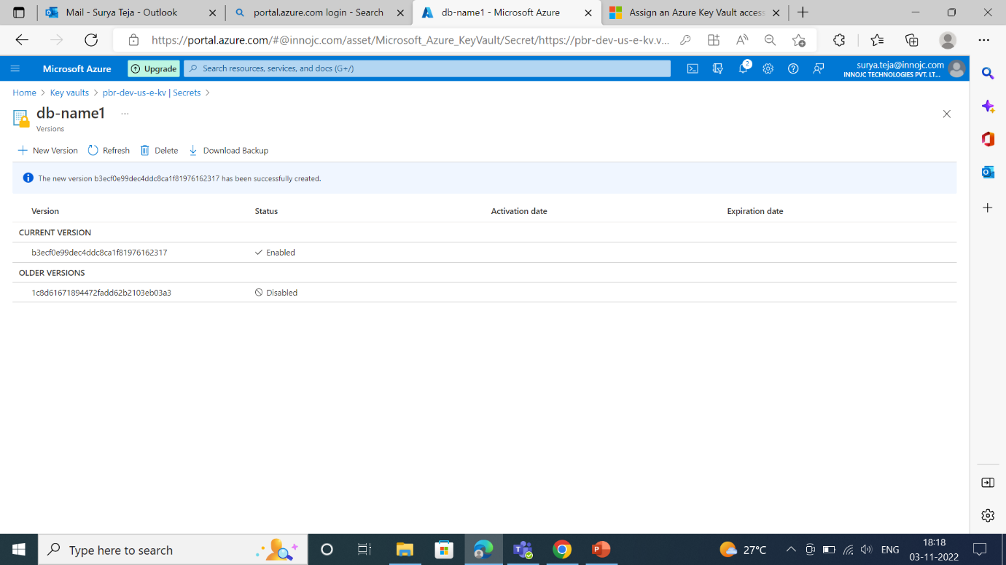

Slide 56
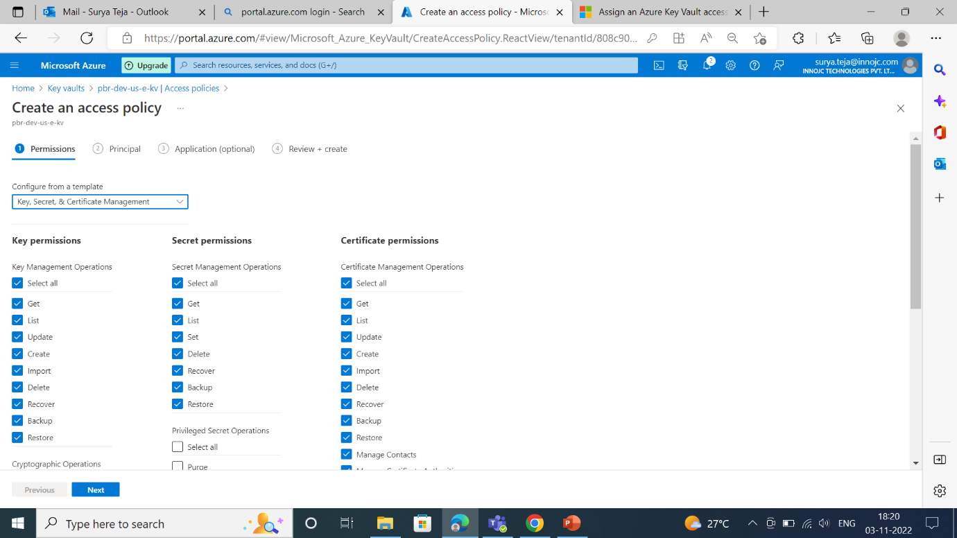
But we have to provide the activation date and expire date for certificates. We are giving the access to others so we are providing the access policy.

Slide 57
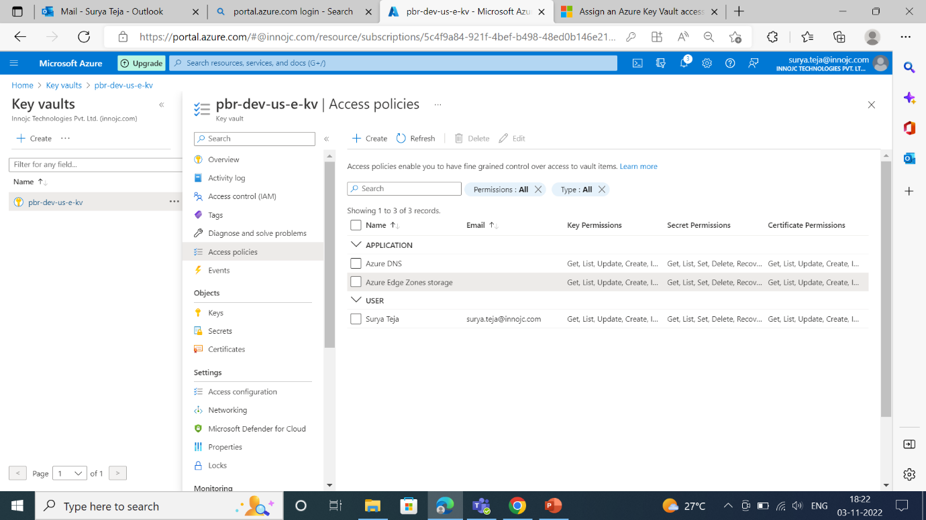
We ae giving the access to the one application like, Azure DNS and Azure edge zone storage.

Slide 58
APIM Services:
APIM stands for application programming interface management.
We should allow the users to communicate with system and also to take the response back so for that we are maintaining API management services.

Slide 59
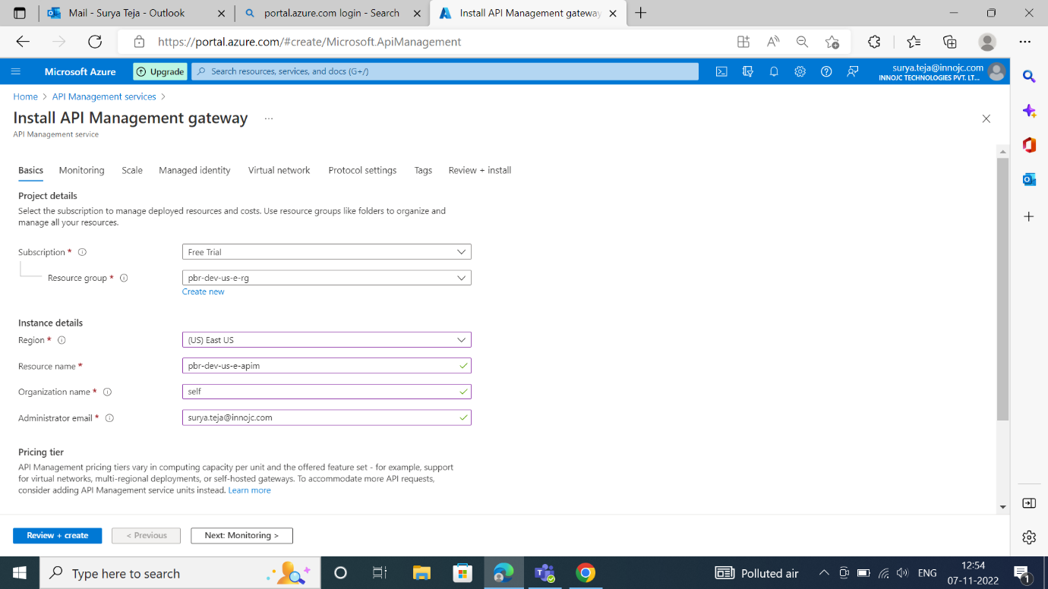

Slide 60
Azure API management is made up of an API gateway, a management plan and a developer portal.
While installing the APIM we are creating the subnet.
We have to allocate the network security group while installing the APIM.

Slide 61
